Slide 1
NHÓM 2
CARO PROJECT
GVHD: TS. TRUONG TOAN THINH
1

Slide 2
THÀNH VIÊN
Phạm Anh Tuấn
The Game’s Voice
Đỗ Chí Cao
The UI Ninja
24120238
24120270
Võ Lân Tuấn
Leader - The Bot’s Brain
24120240
Trần Huỳnh Gia Bảo
The Files Lord
Võ Nguyễn Việt Hoàng
The Pixel Wizard
24120267
24120249
2

Slide 3
NỘI DUNG
1. Tổng quan.
2. GUI.
3. Game Play.
4. Save game, Load game.
5. Language.
3

Slide 4
TỔNG QUAN
Tên sản phẩm?
Mục tiêu?
Đối tượng?
4

Slide 5
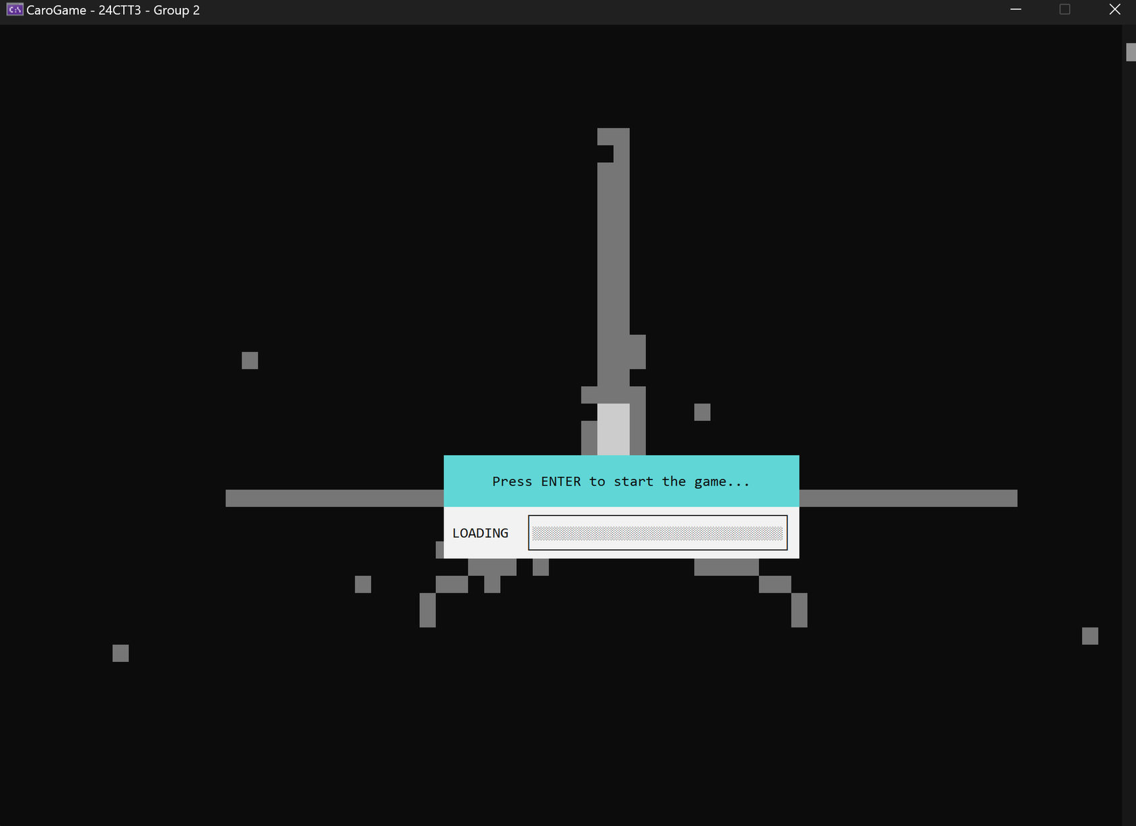
5

Slide 6
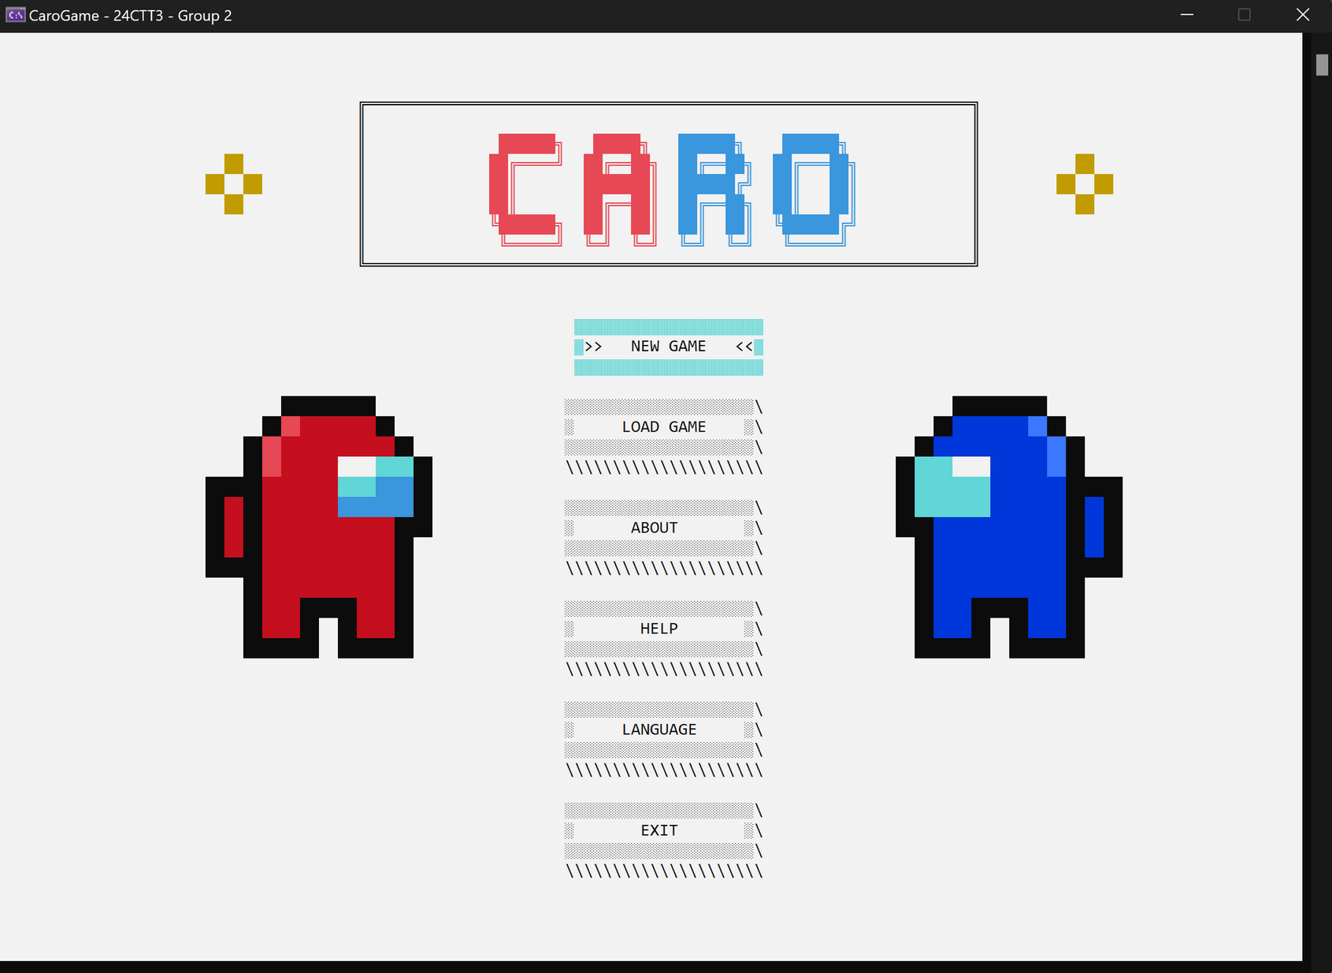
6

Slide 7
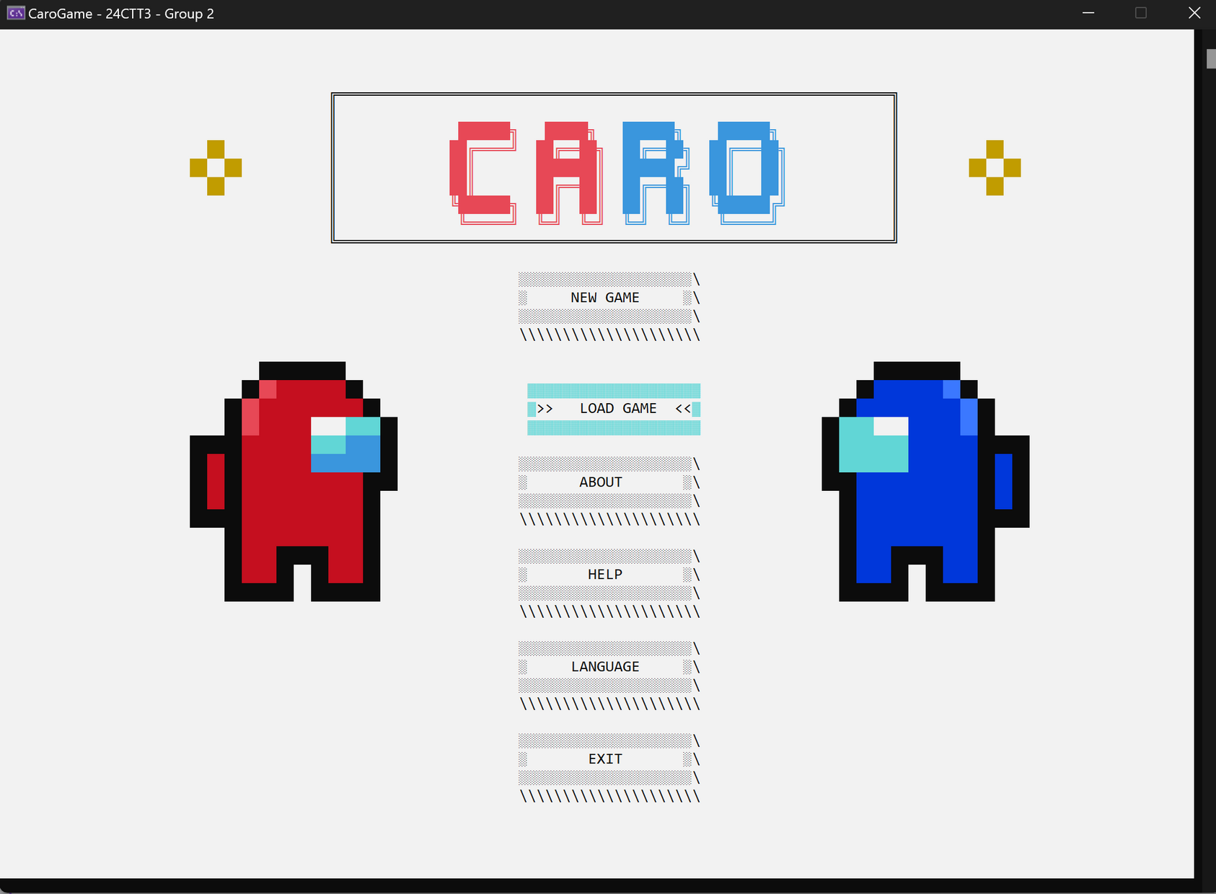
7

Slide 8
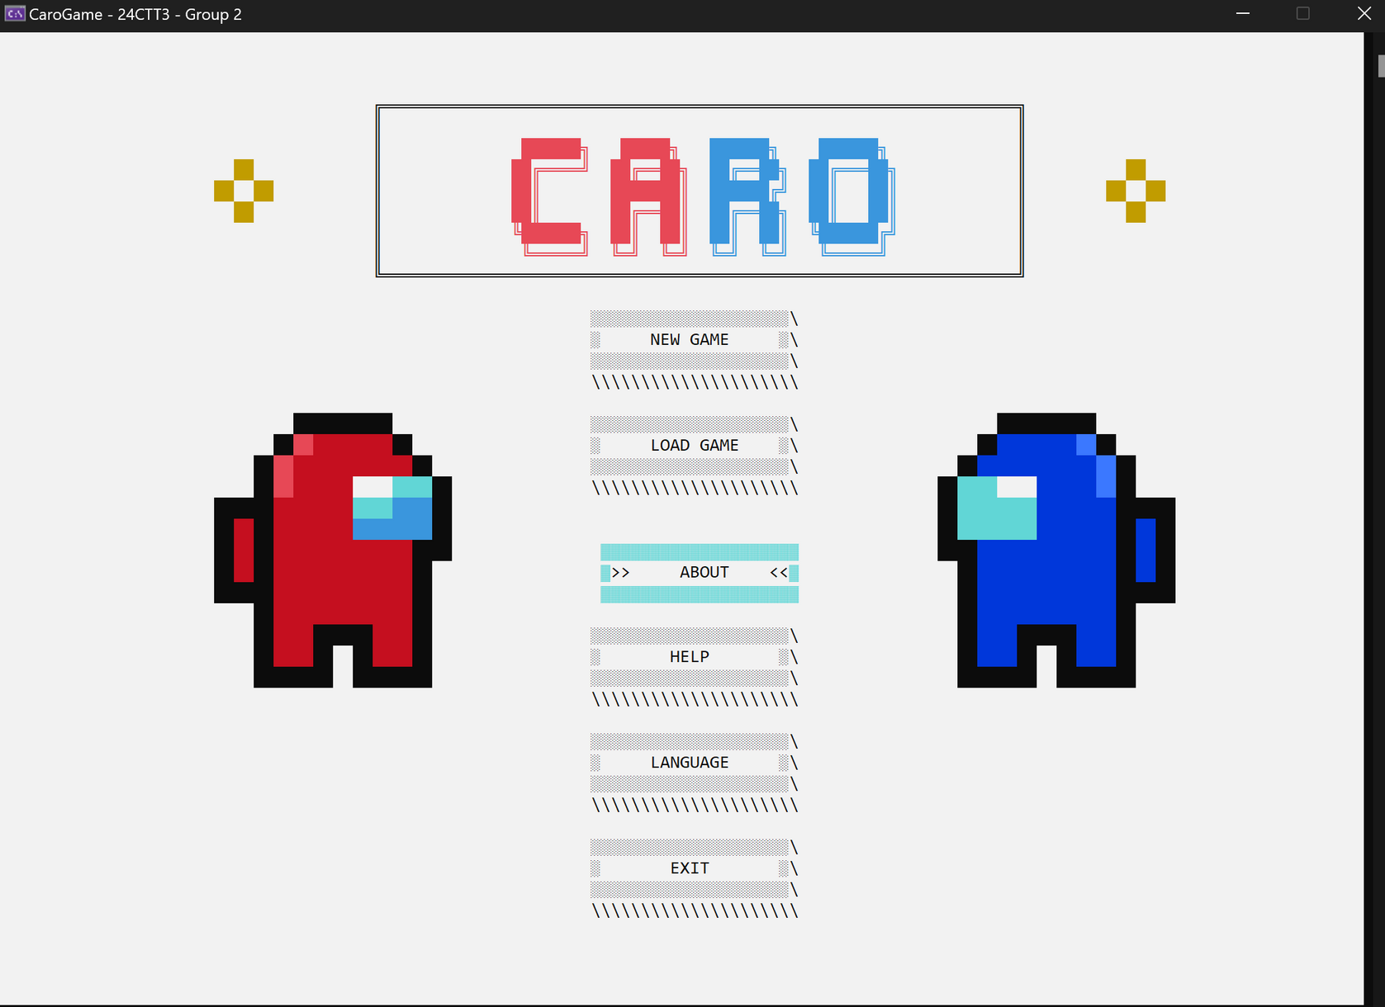
8

Slide 9
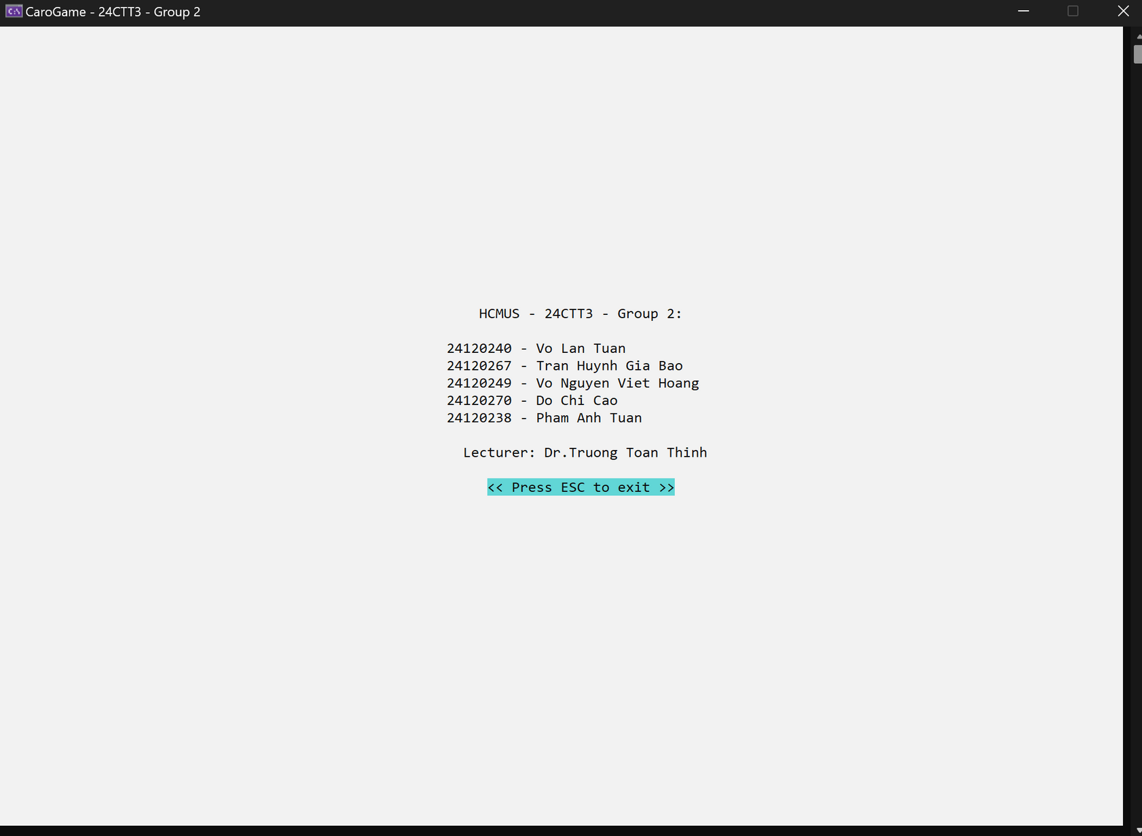
9

Slide 10
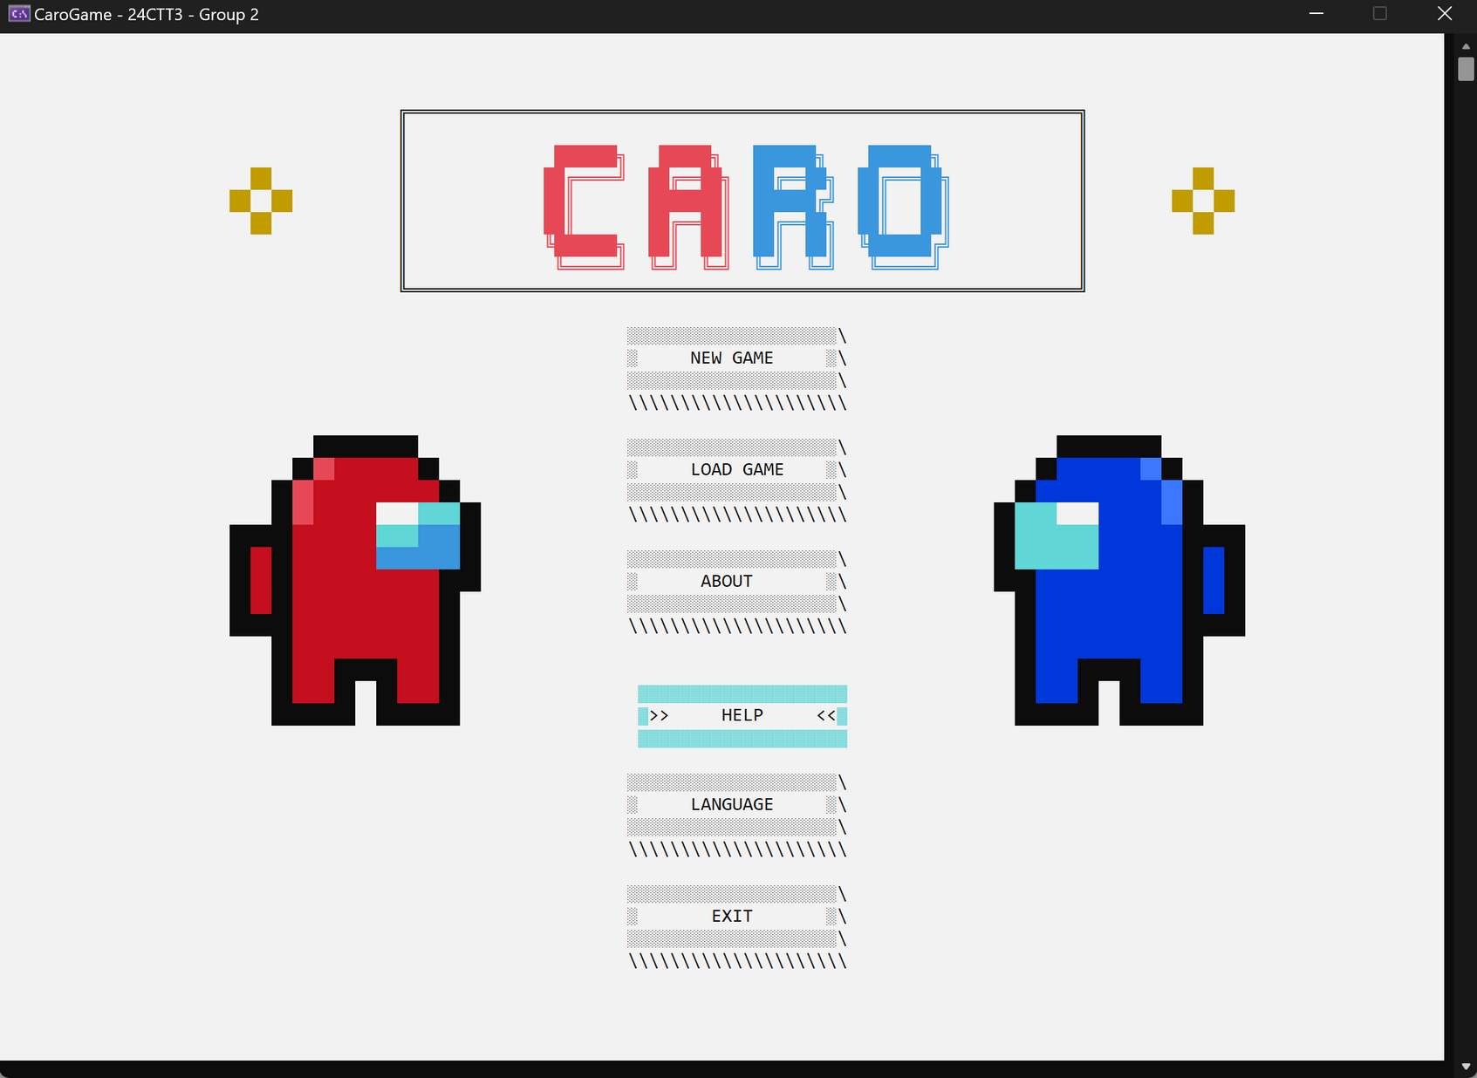
10

Slide 11
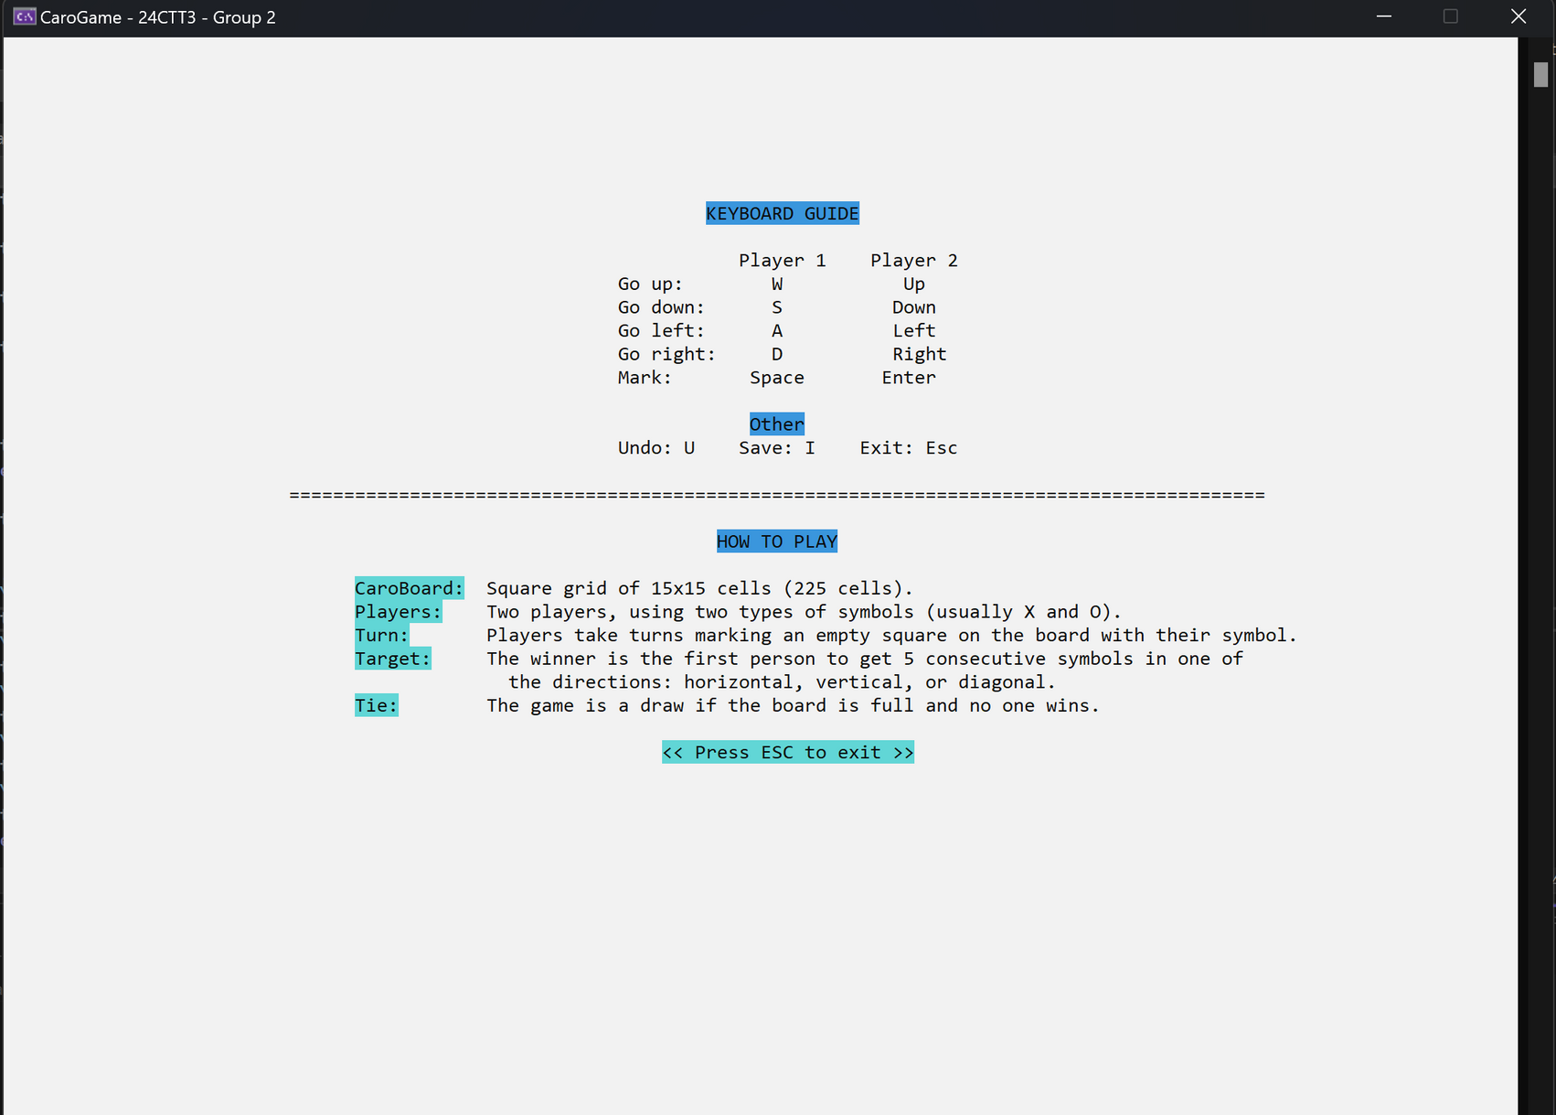
11

Slide 12
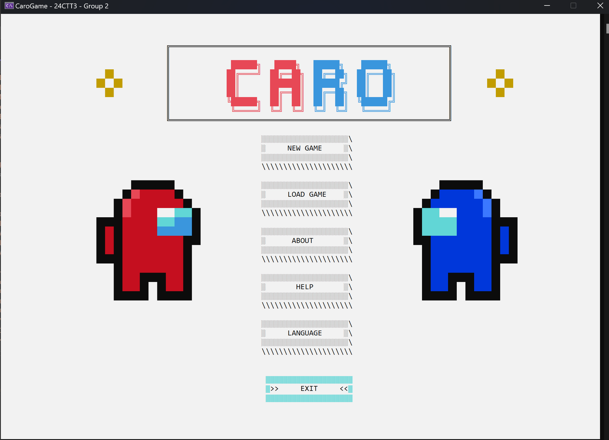
12

Slide 13
GUI, UX/UI
13

Slide 14
GUI, UI/UX
ASCII mở rộng
ANSI color codes.
14

Slide 15
GUI, UI/UX
cout << char(186);
draw_square(0, 0, 0, 0, 4);
15

Slide 16

GUI, UI/UX
║
16

Slide 17


GUI, UI/UX
17

Slide 18

GUI, UI/UX
/I\
//I\\
///I\\\
'//I\\'
'I'
txtDraw(0, 0, “file.txt”);
decorate_draw(0, 0, “file.txt”);
15 6 15
6 15 6
15 6 15
18

Slide 19

GUI, UI/UX
pic.txt
15 15 15 15 0 0 0 0 0 15 15 15
15 15 15 0 12 4 4 4 4 0 .......
19

Slide 20
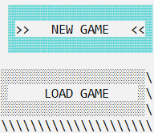
GUI, UI/UX
20

Slide 21





GUI, UI/UX
21

Slide 22
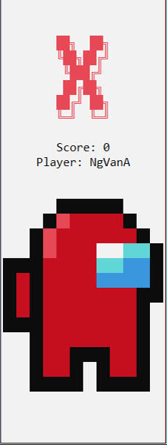
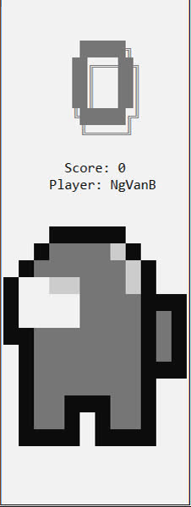
GUI, UI/UX
22

Slide 23
GAMEPLAY
23

Slide 24
GAMEPLAY
PVP
PvB & Thuật toán.
24

Slide 25
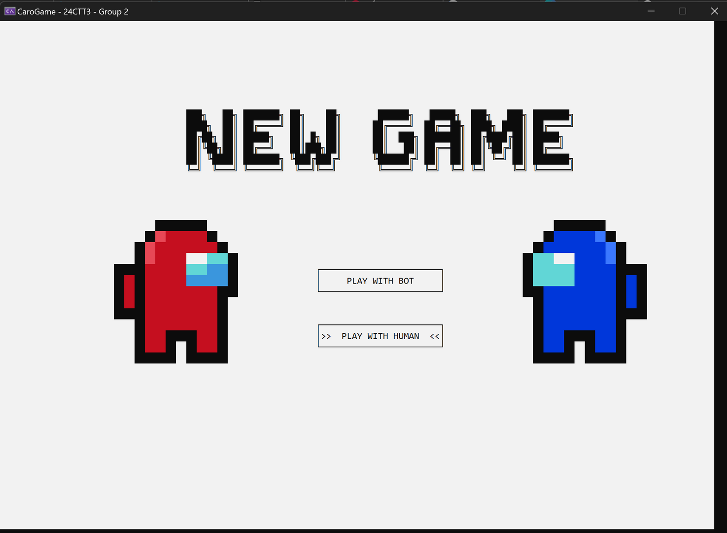
PVP
25

Slide 26
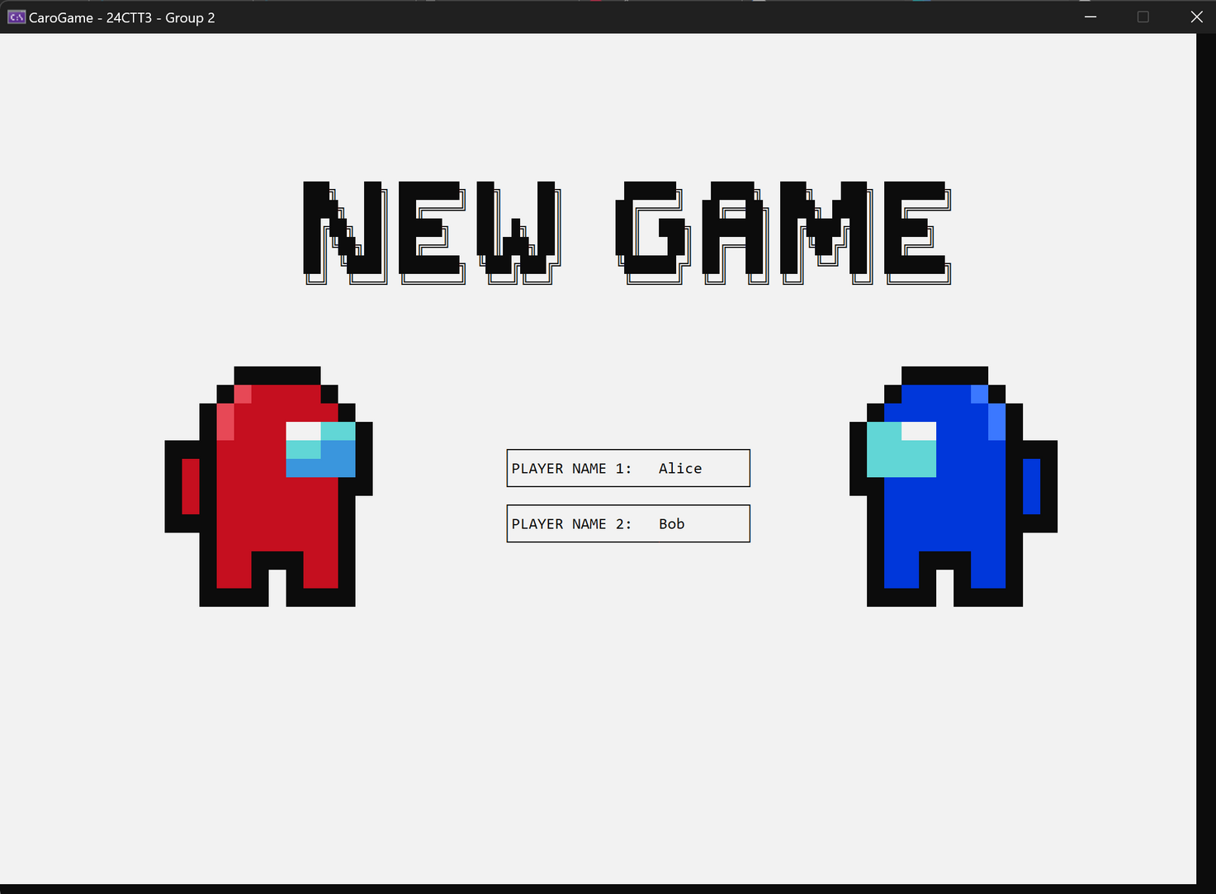
PVP
26

Slide 27
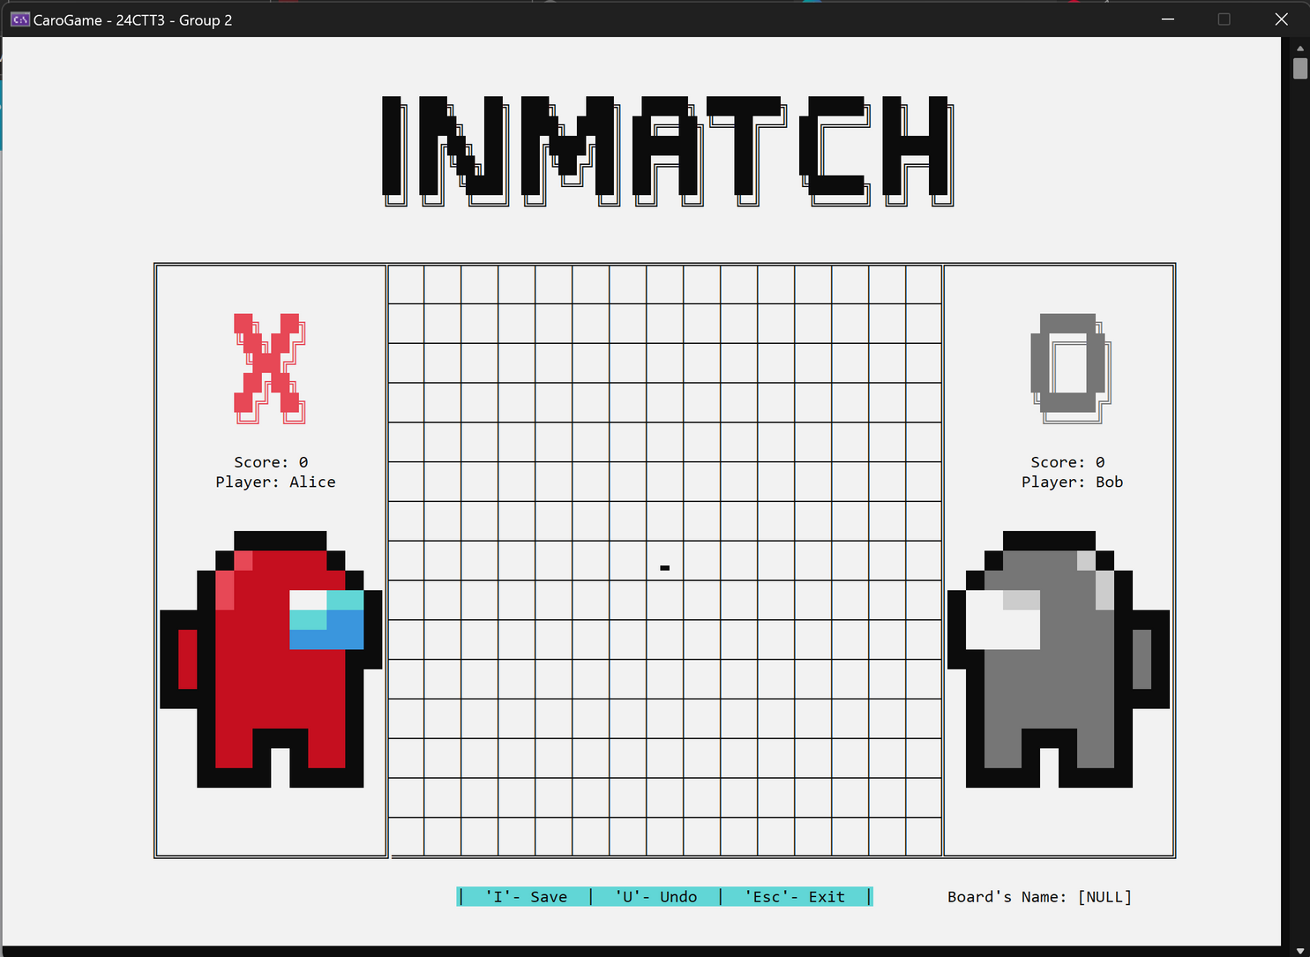
PVP
27

Slide 28
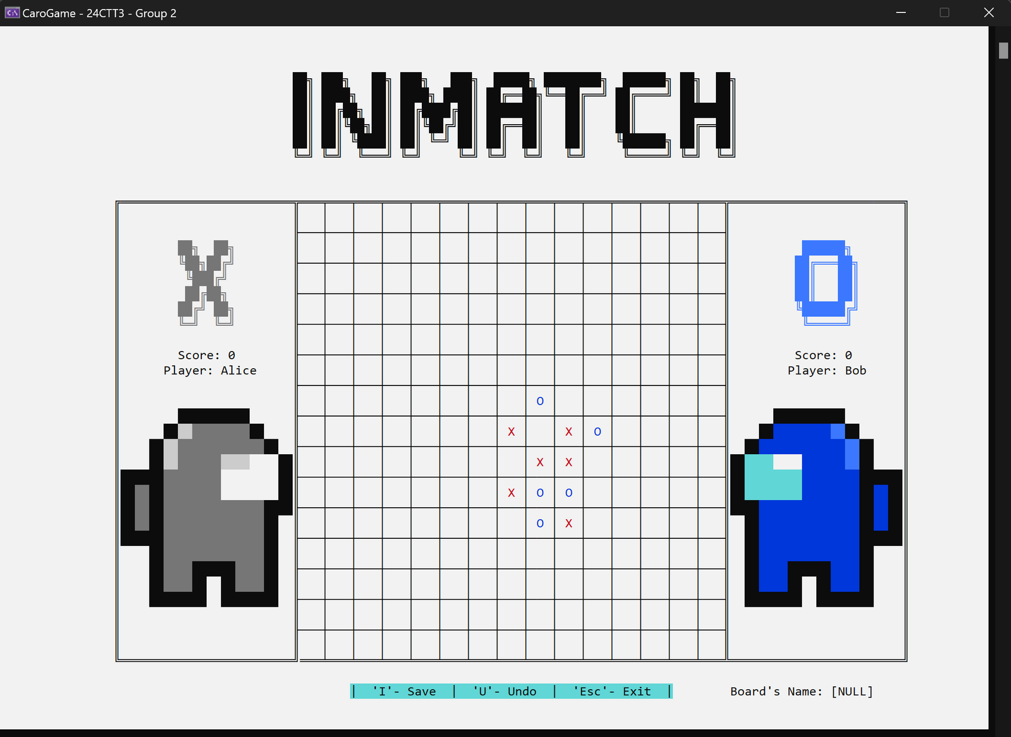
PVP
28

Slide 29
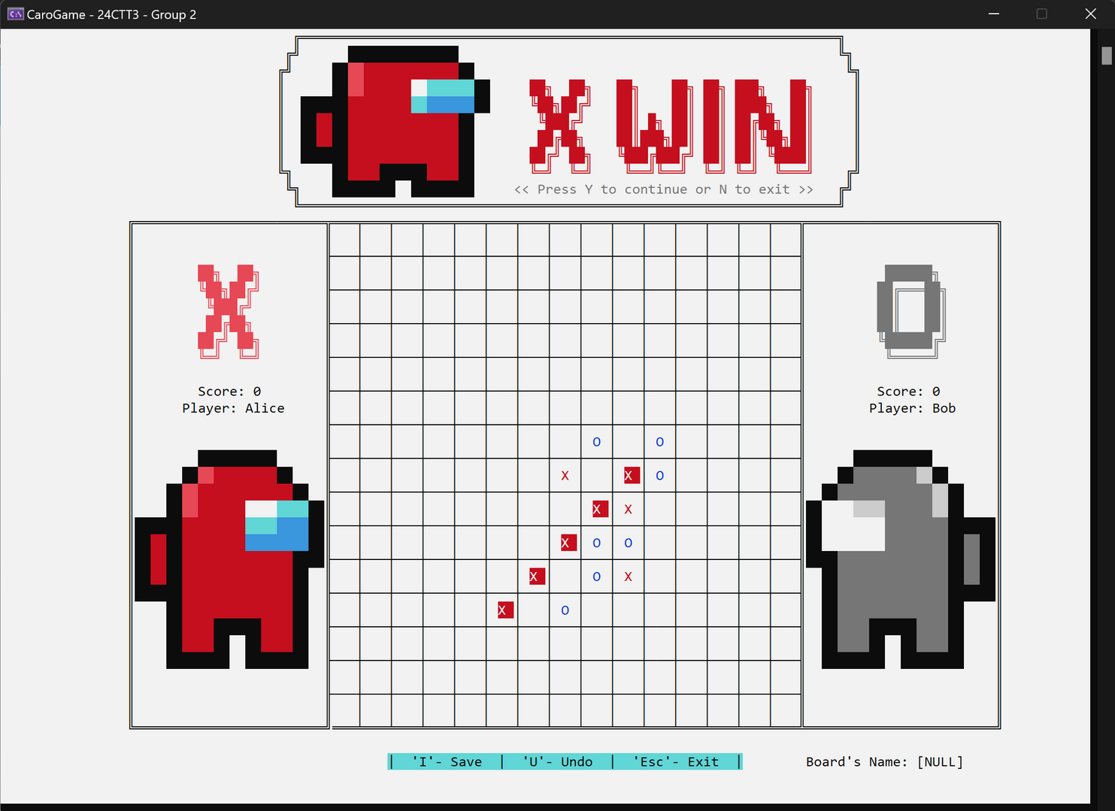
PVP
29

Slide 30
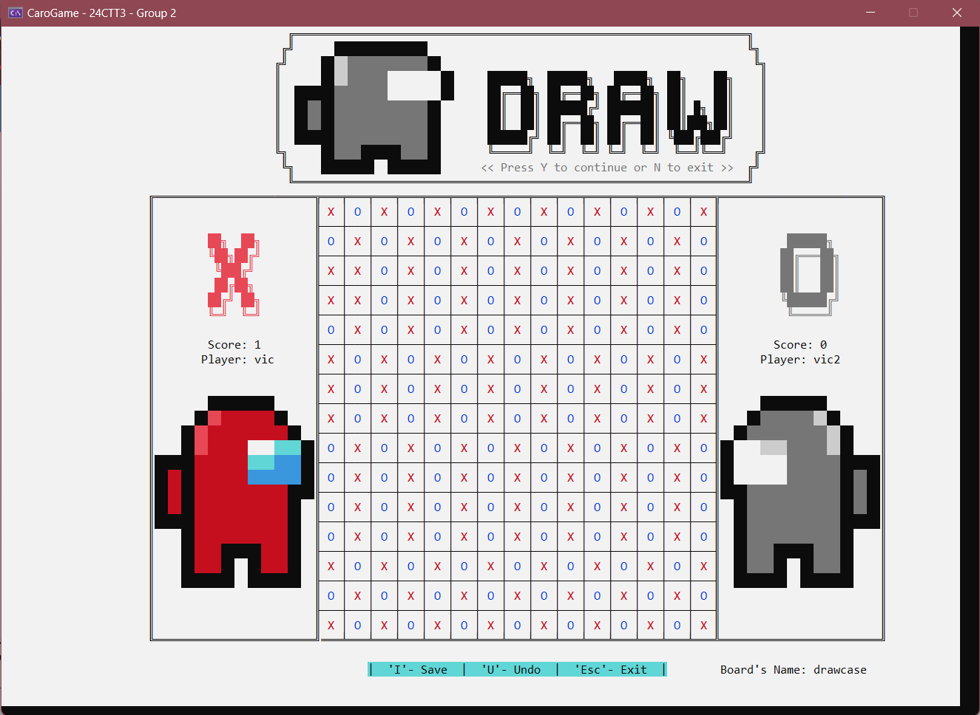
PVP
30

Slide 31
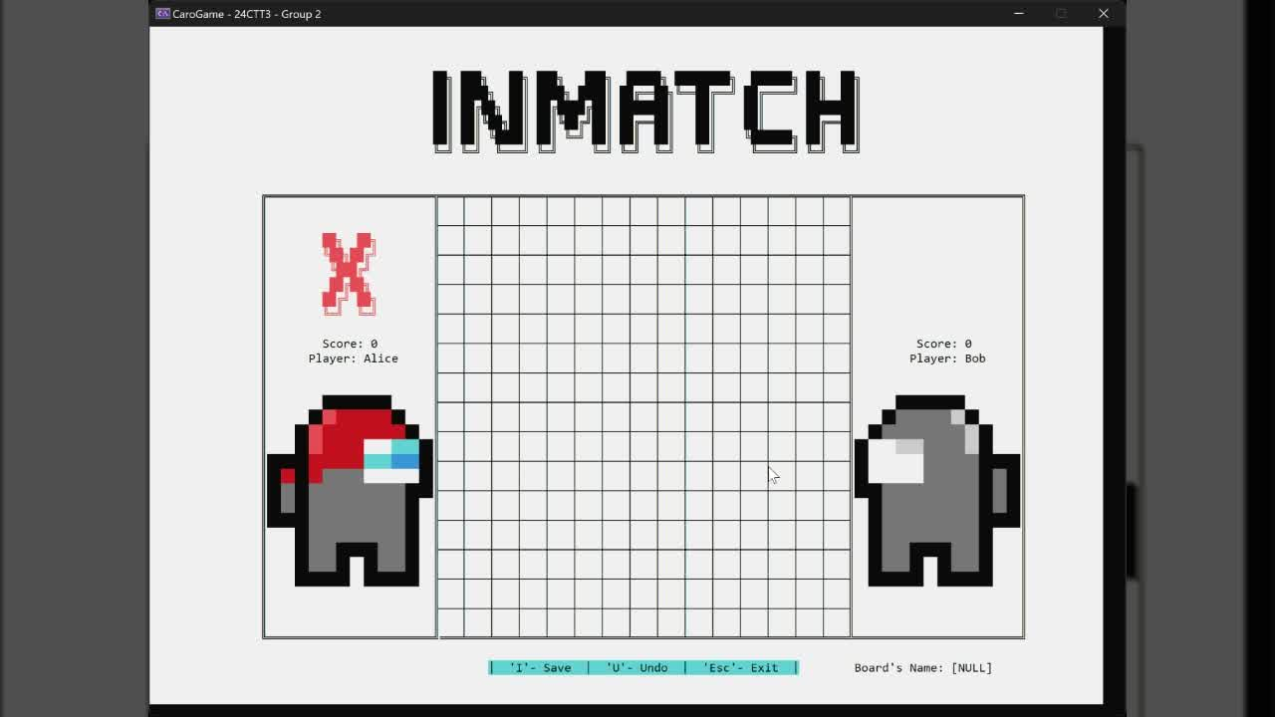
DEMO PVP
31

Slide 32
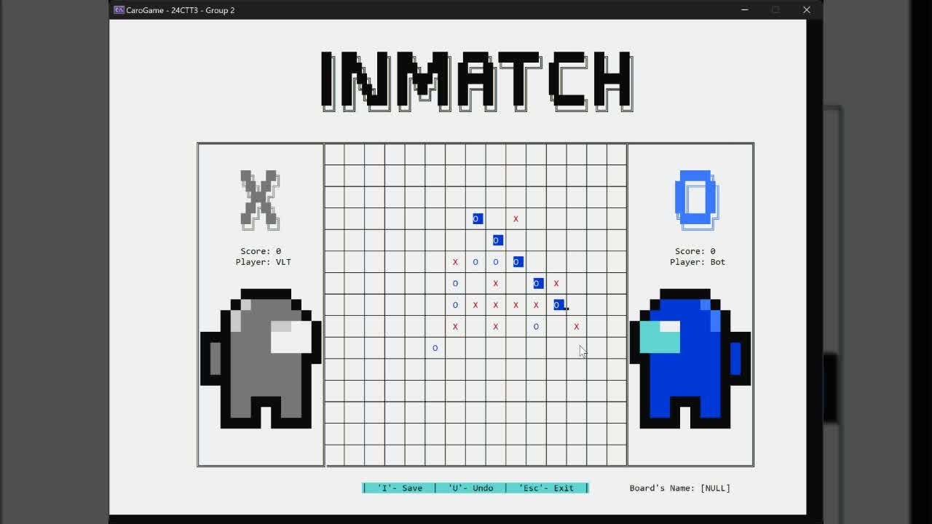
PLAYER VS BOT
32

Slide 33
THUẬT TOÁN
Minimax.
Move prioritization.
Depth-limit search.
Board evaluation.
Alpha-beta pruning.
33

Slide 34
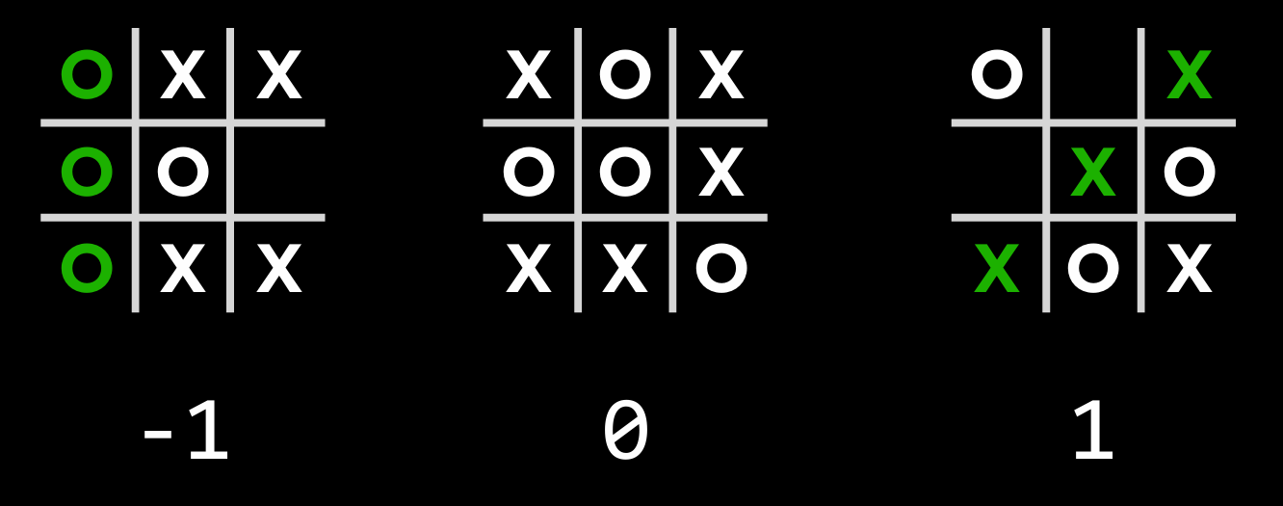
Minimax
Nguồn: CS50 - 09/12
34

Slide 35
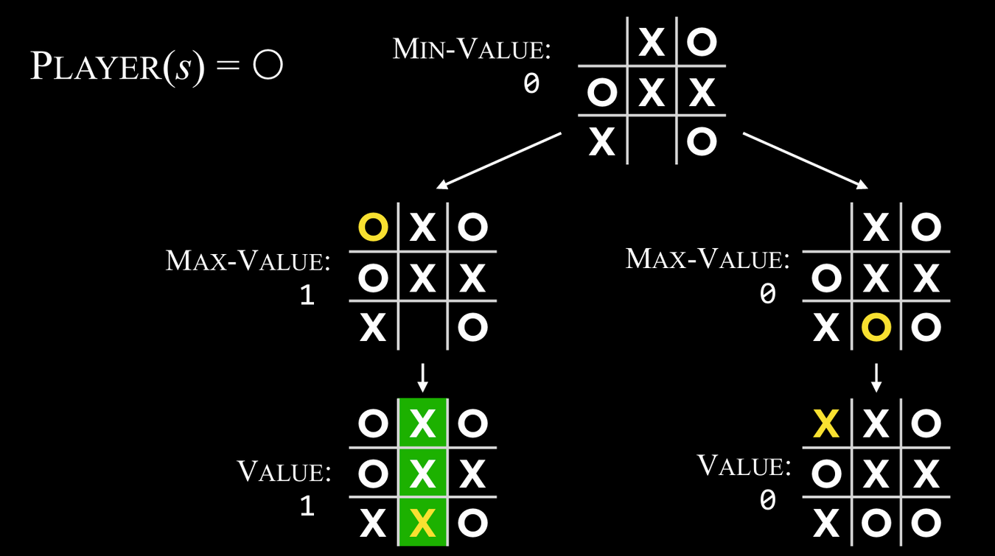
Minimax
Nguồn: CS50 - 09/12
35

Slide 36
Minimax
255,168
Tổng số trạng thái có thể xảy ra của TicTacToe
36

Slide 37
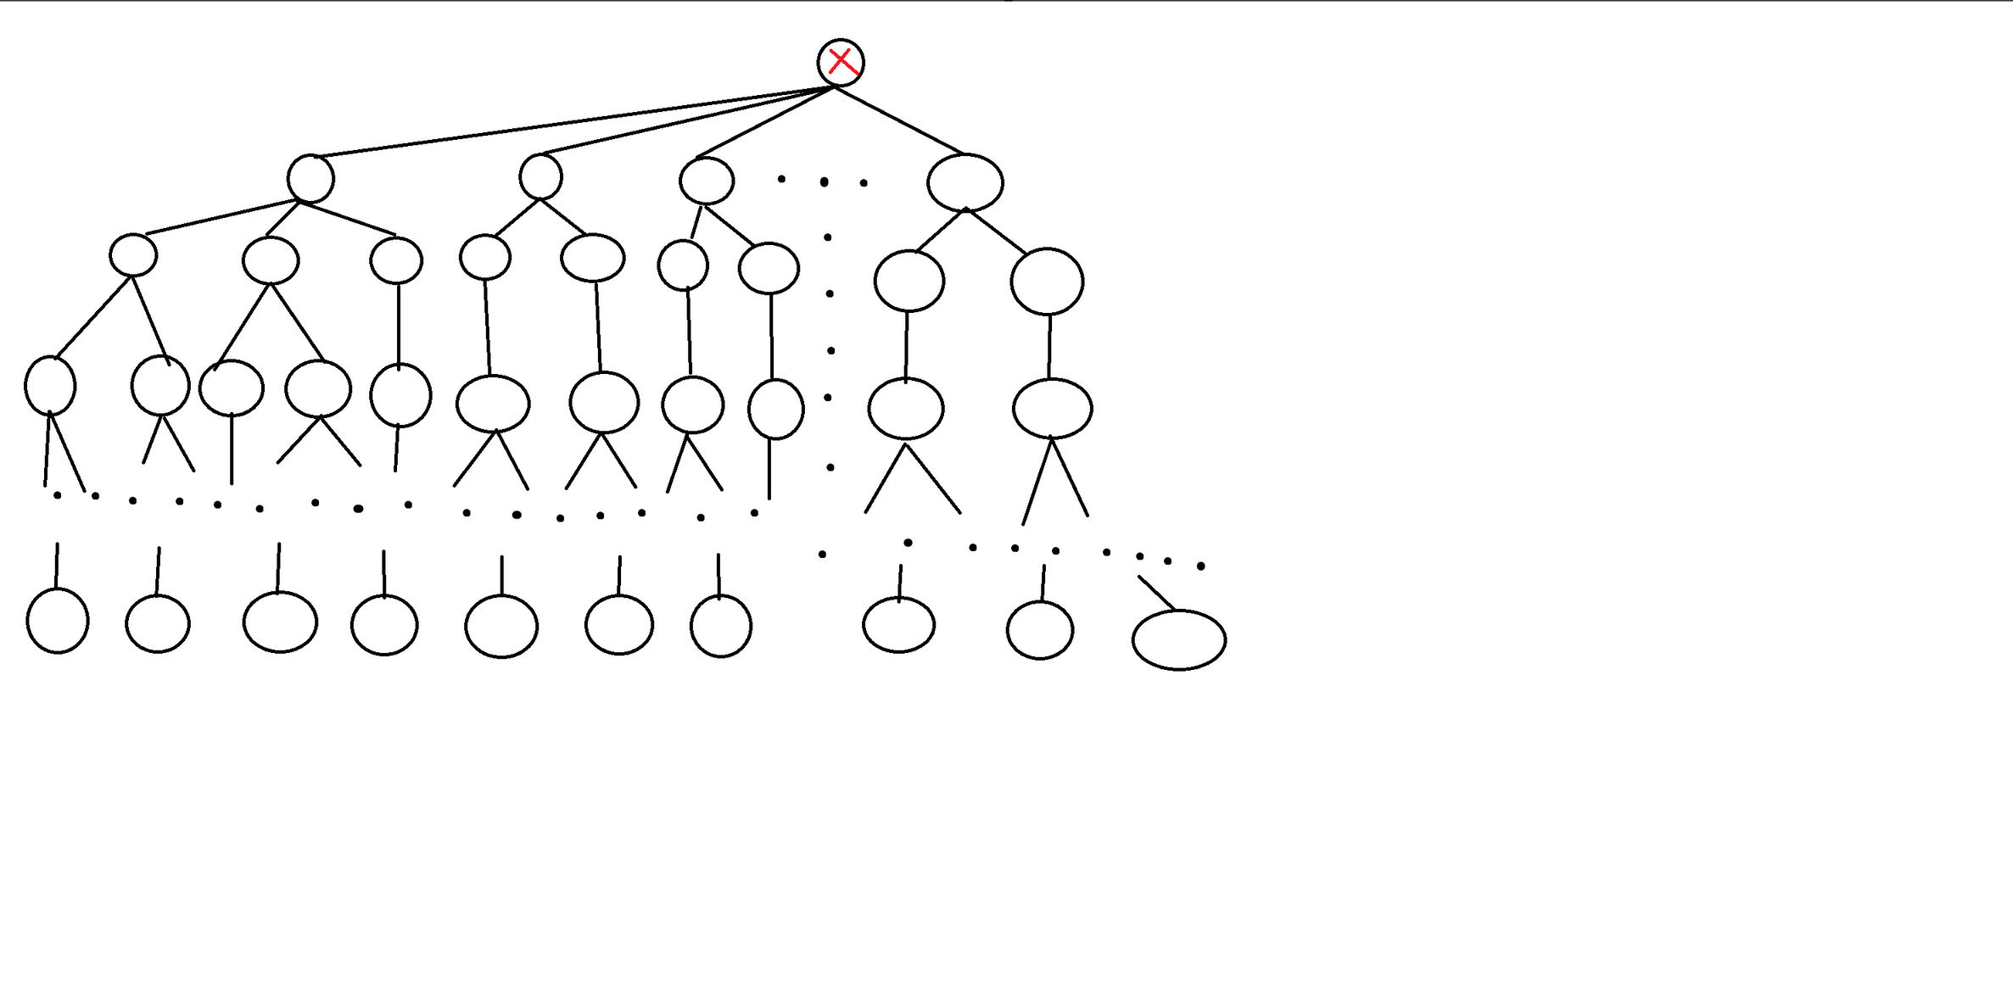
Move prioritization
37

Slide 38
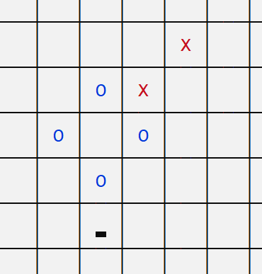
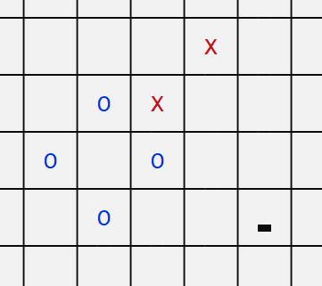
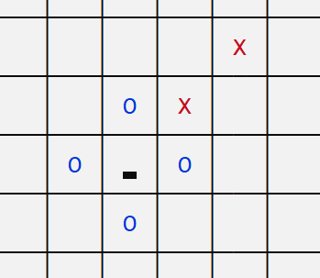
Move prioritization
38

Slide 39
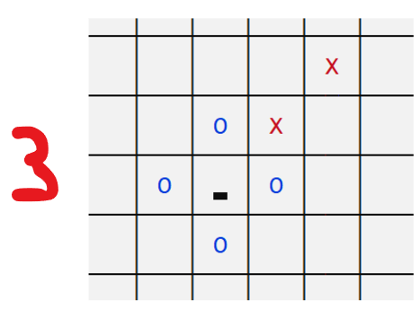
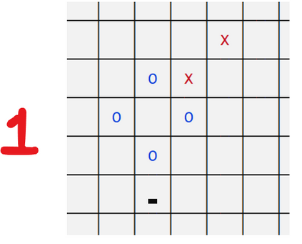
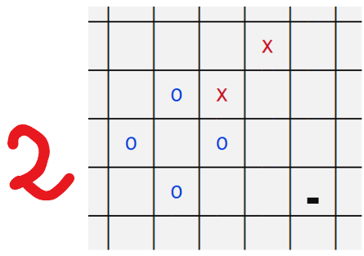
Move prioritization
39

Slide 40
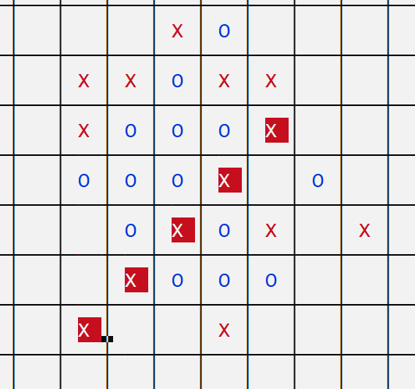
Move prioritization
int GameValue(){
...
return 1;
}
40

Slide 41
Move prioritization
int MoveGoodness(char cur_player, int row, int col) {
// Return how “good” a move is
noth = 0;
int mx = 0;
if (isWinningState(cur_player, row, col)) return 100000;
bool tmp = isWinningState2(cur_player, row, col);
if (IsLosingState(cur_player)) {
if (noth) return -500;
mx = max(mx, ThreeInARow(cur_player, row, col));
if (AroundTheCenter(row, col)) mx += 2;
if (mx) return -200;
return -100000;
}
if (BlockOPsWin((cur_player == 'X' ? 'O' : 'X'), row, col)) return 20000;
if (tmp) return 10000;
if (isLosingState2(cur_player)) {
if (noth) return -500;
mx = max(mx, ThreeInARow(cur_player, row, col));
if (AroundTheCenter(row, col)) mx += 2;
if (mx) return -200;
return -10000;
}
if (BlockOP_connectPath(cur_player, row, col)) {
return 5000;
}
mx = 0;
mx = max(mx, BlockOpponent(cur_player, row, col));
mx = max(mx, ThreeInARow(cur_player, row, col));
mx = max(mx, BlockOpponent2((cur_player == 'X' ? 'O' : 'X'), row, col));
bool c = ThreeInARowOpponent((cur_player == 'X' ? 'O' : 'X'));
if (AroundTheCenter(row, col) && !c) mx += 2;
if (mx) return mx;
if (c) return -5;
return 1;
}
41

Slide 42
Depth-limit search & Board Evaluation
42

Slide 43
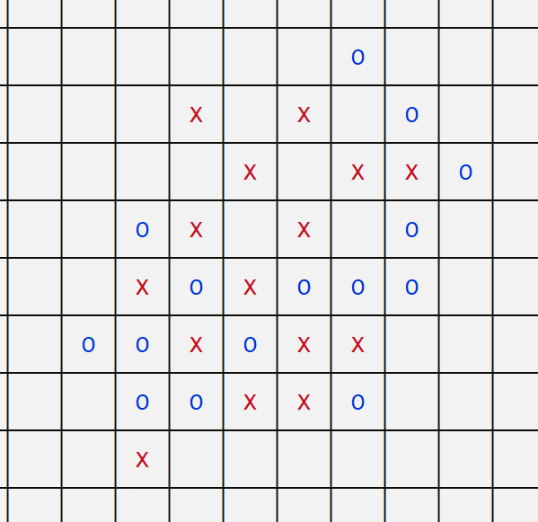
Depth-limit search & Board Evaluation
int BoardEvaluation(){
...
if next_player_is_X:
return 100
else -100
}
43

Slide 44
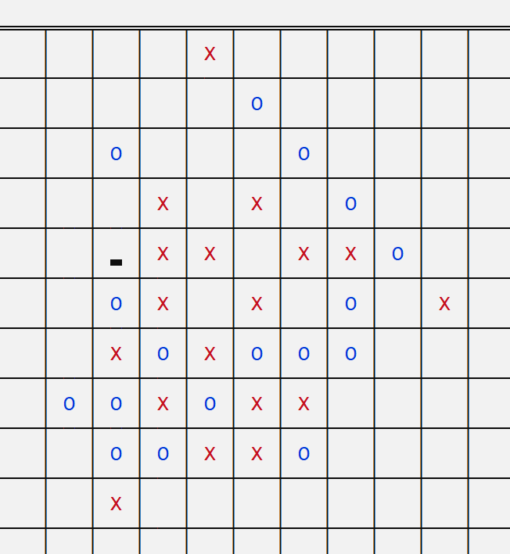
Depth-limit search & Board Evaluation
int BoardEvaluation(){
...
if next_player_is_X:
return 10000
else -10000
}
44

Slide 45
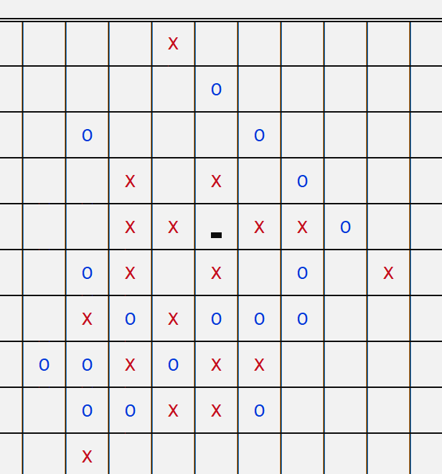
Depth-limit search & Board Evaluation
int BoardEvaluation(){
...
if next_player_is_X:
return 10000
else -10000
}
45

Slide 46
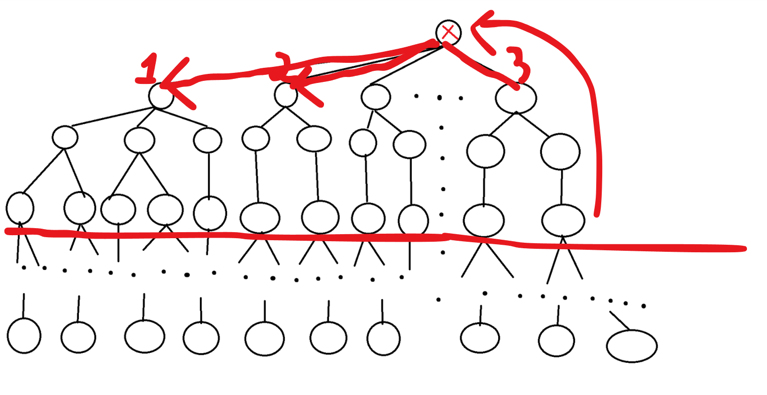
Depth-limit search & Board Evaluation
46

Slide 47
Depth-limit search & Board Evaluation
ii minimax() {
return min_turn(-INF, INF, min(6, cnt_moves / 2 + 1), 0).move; // (alpha, beta, depth, evaluation)
}
47

Slide 48
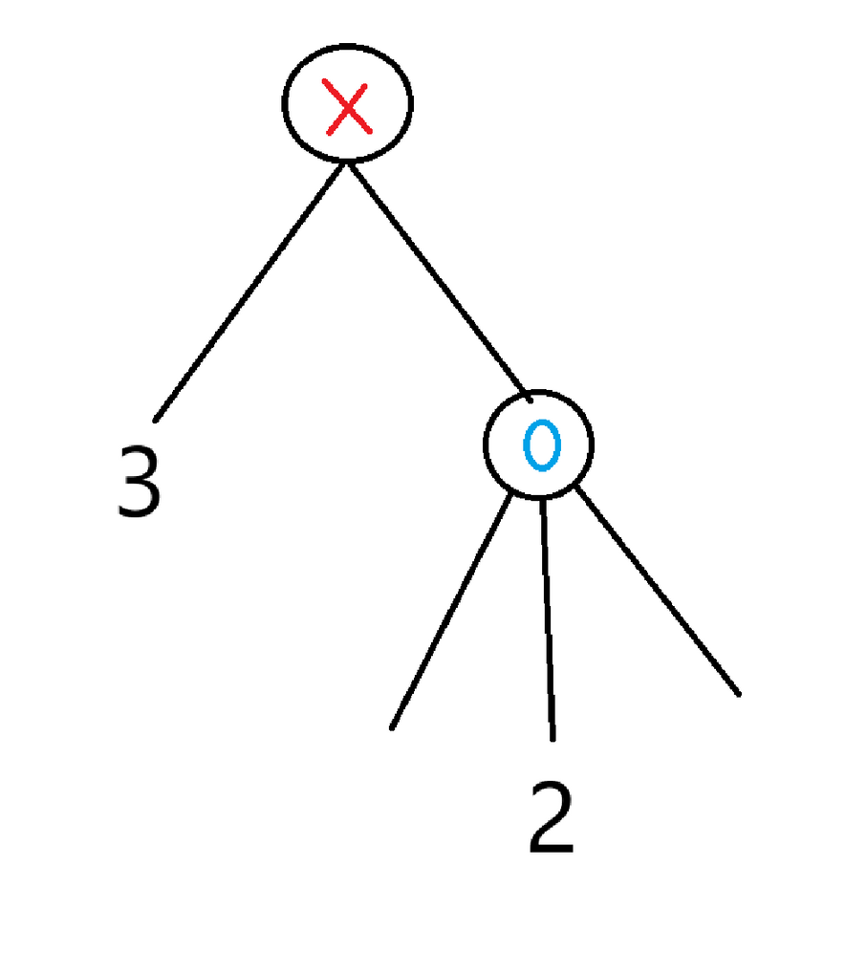
Alpha-beta pruning
48

Slide 49
Alpha-beta pruning
FUNCTION min_turn(alpha, beta, depth, evaluation):
// Check if we should stop
IF depth = 0 OR game_is_over():
RETURN (evaluation, NO_MOVE)
// Generate and sort possible moves by their quality
possible_moves ← generate_moves()
moves ← EVALUATE_AND_SORT(possible_moves)
best_score ← INFINITY // Start with a very high score (we want to minimize)
best_move ← NULL // No best move initially
// Explore the top moves (pruned by depth)
FOR move IN top_moves(moves, 8 + 2 * depth):
MAKE_MOVE(move) // Simulate the move
score ← max_turn(alpha, beta, depth - 1, -move.evaluation).score
UNDO_MOVE(move) // Undo the simulated move
// Update best score and best move if this move is better
IF score < best_score:
best_score ← score
best_move ← move
// Update beta and prune if possible
beta ← MIN(beta, best_score)
IF beta ≤ alpha:
BREAK // Stop early (alpha-beta pruning)
RETURN (best_score, best_move)
FUNCTION minimax() {
return min_turn(-INF, INF, min(6, cnt_moves / 2 + 1), 0).move; // (alpha, beta, depth, evaluation)
}
49

Slide 50
LOADGAME/SAVEGAME
50

Slide 51
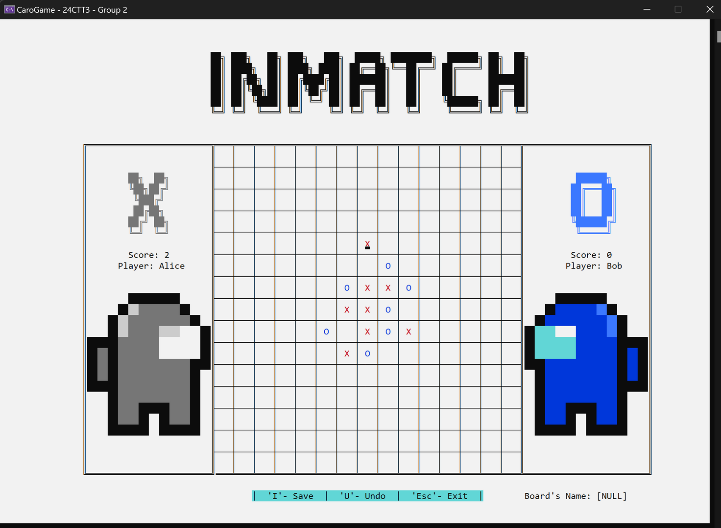
Savegame
51

Slide 52
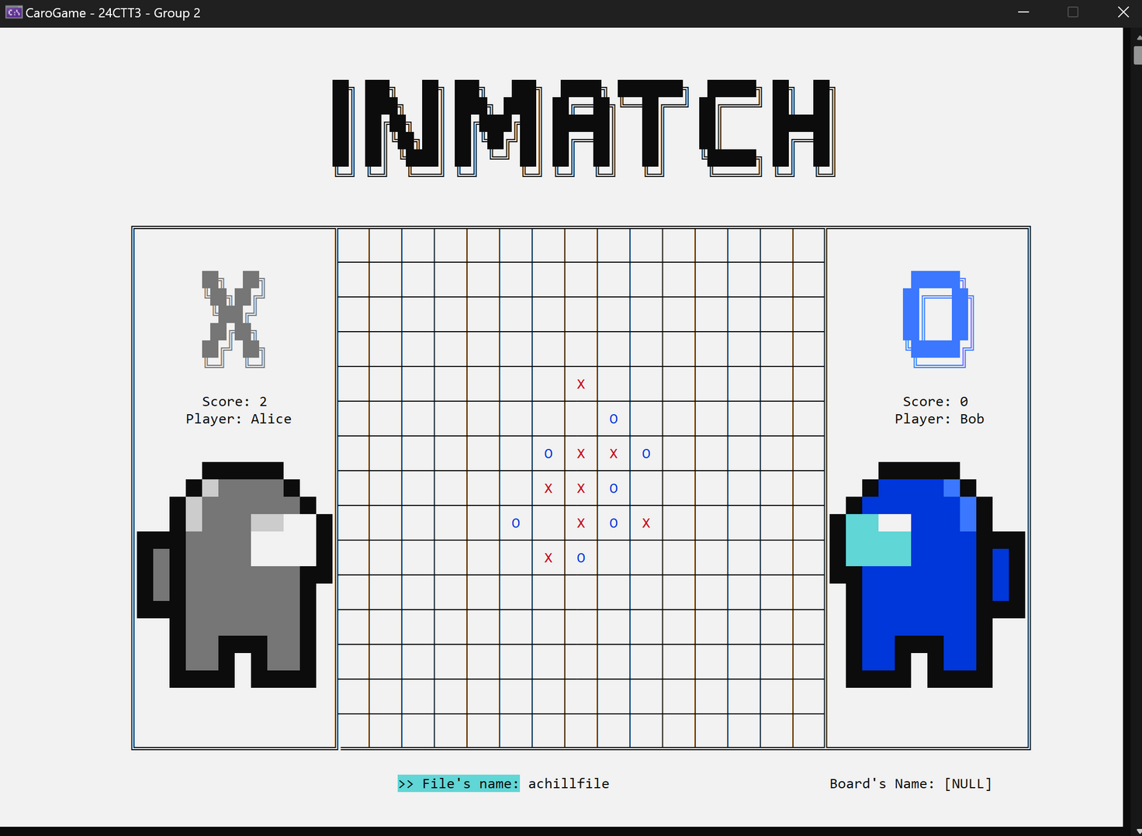
Savegame
52

Slide 53
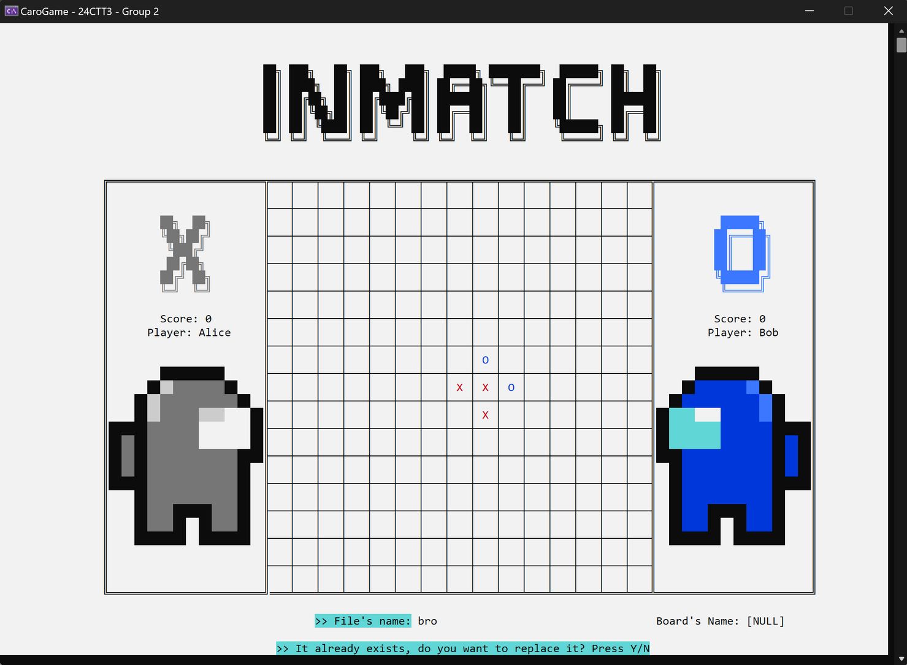
Savegame
53

Slide 54
Savegame
FUNCTION saveGame(XX, YY, moveMade, Xscore, Oscore, name1, name2, nameFile, vsBot):
WHILE nameFile is empty:
PROMPT user for file name, RETURN if canceled
IF nameFile exists in fileSave:
PROMPT overwrite confirmation, RETURN if 'No'
IF fileSave has 15+ files:
REMOVE oldest file
ADD nameFile to fileSave
WRITE (vsBot, Xscore, Oscore, name1, name2, moveMade) to file (nameFile + ".txt")
54

Slide 55
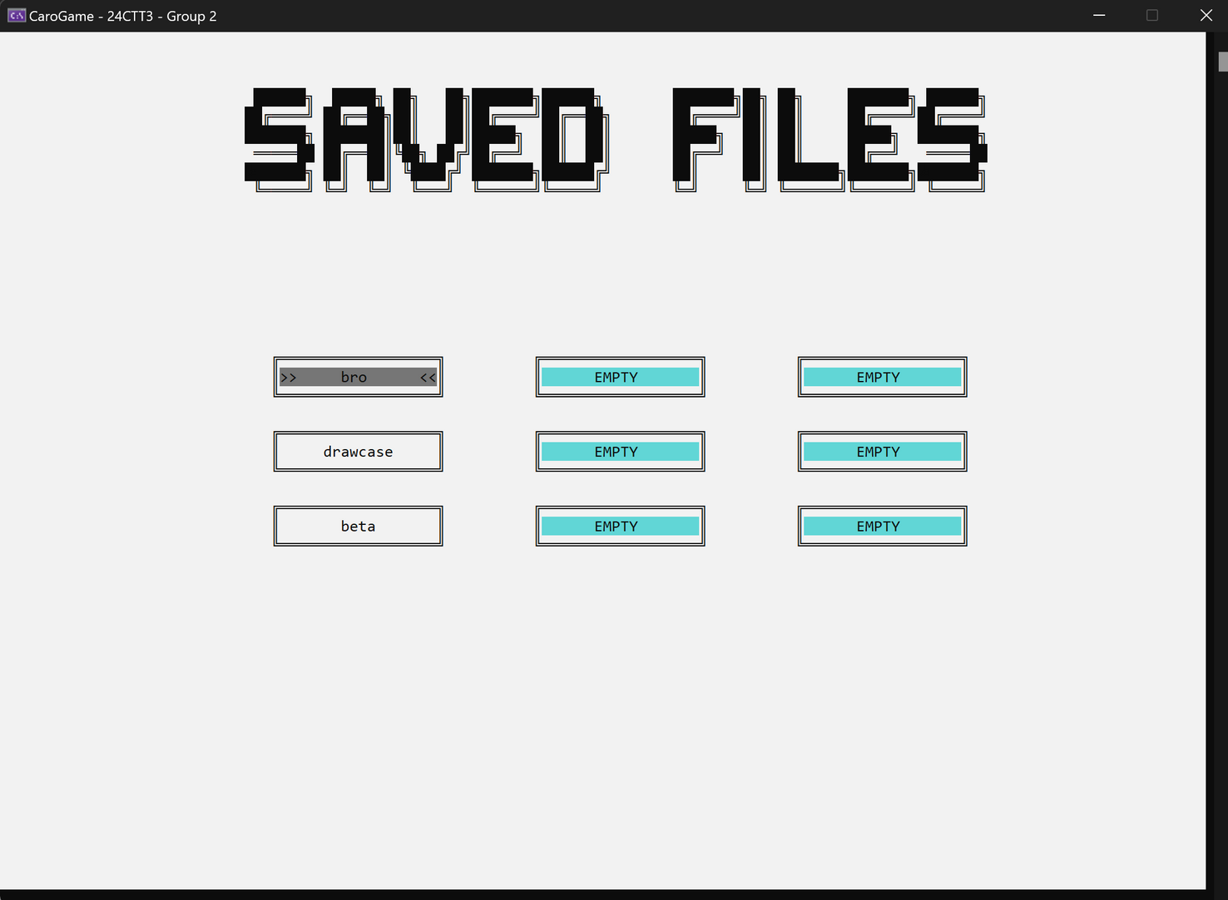
Load game
55

Slide 56
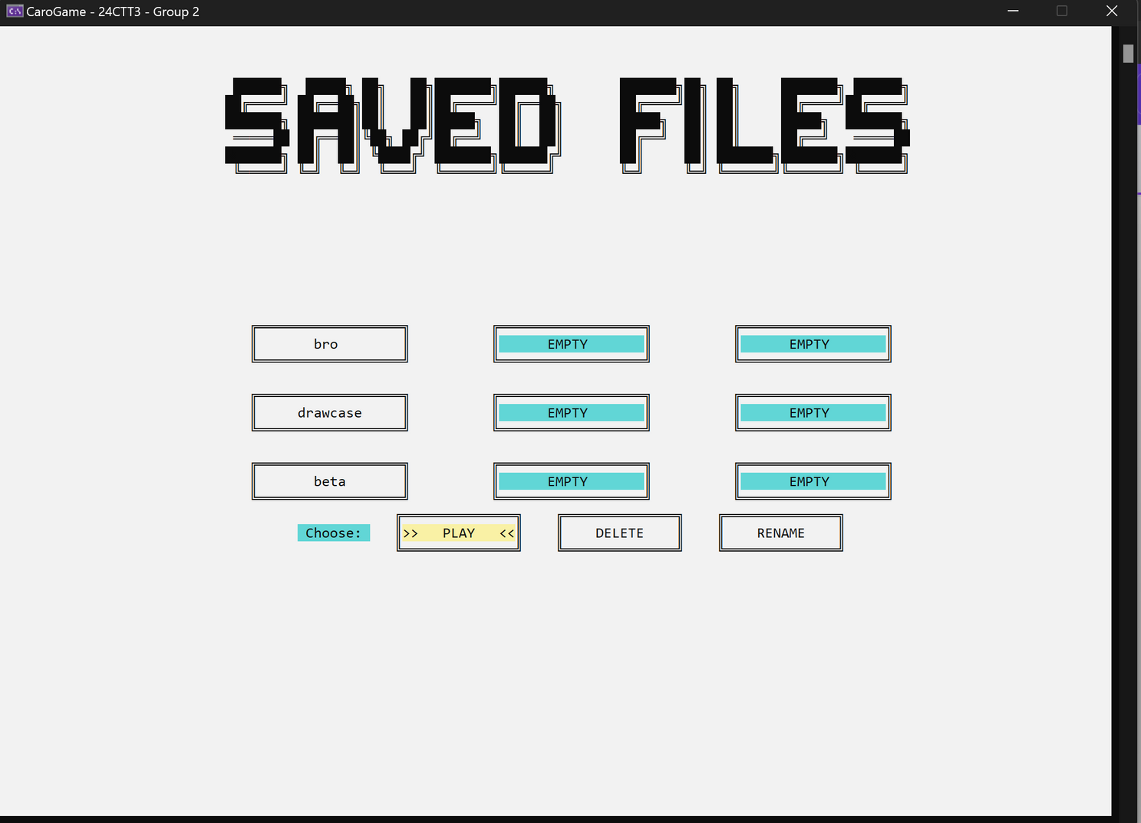
Load game
56

Slide 57
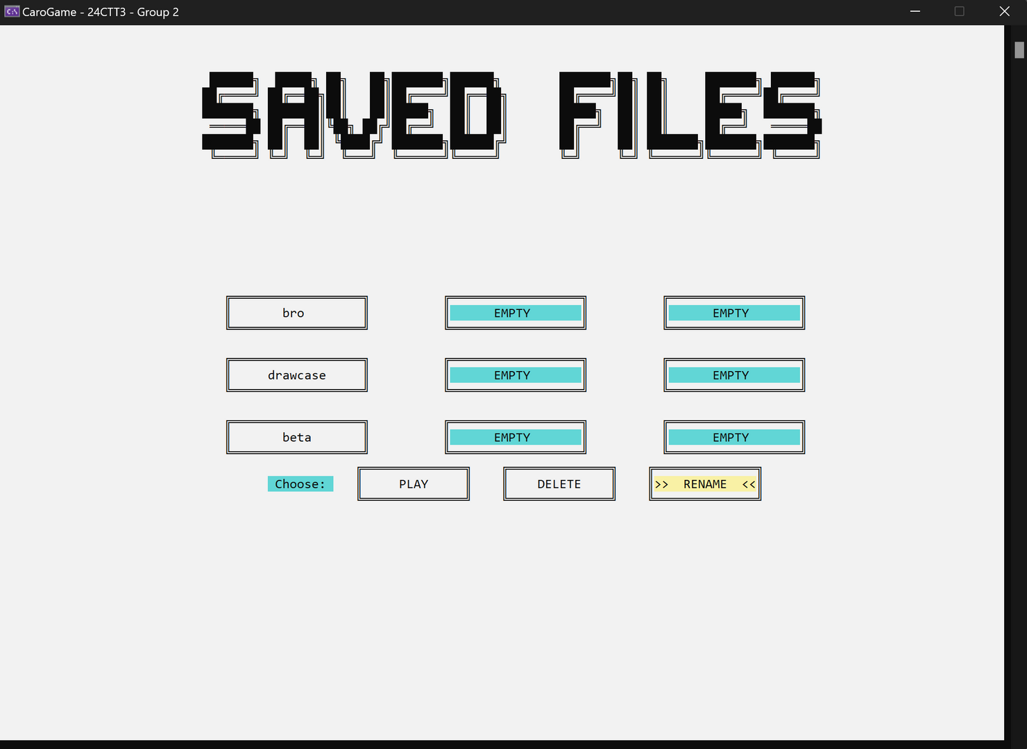
Load game
57

Slide 58
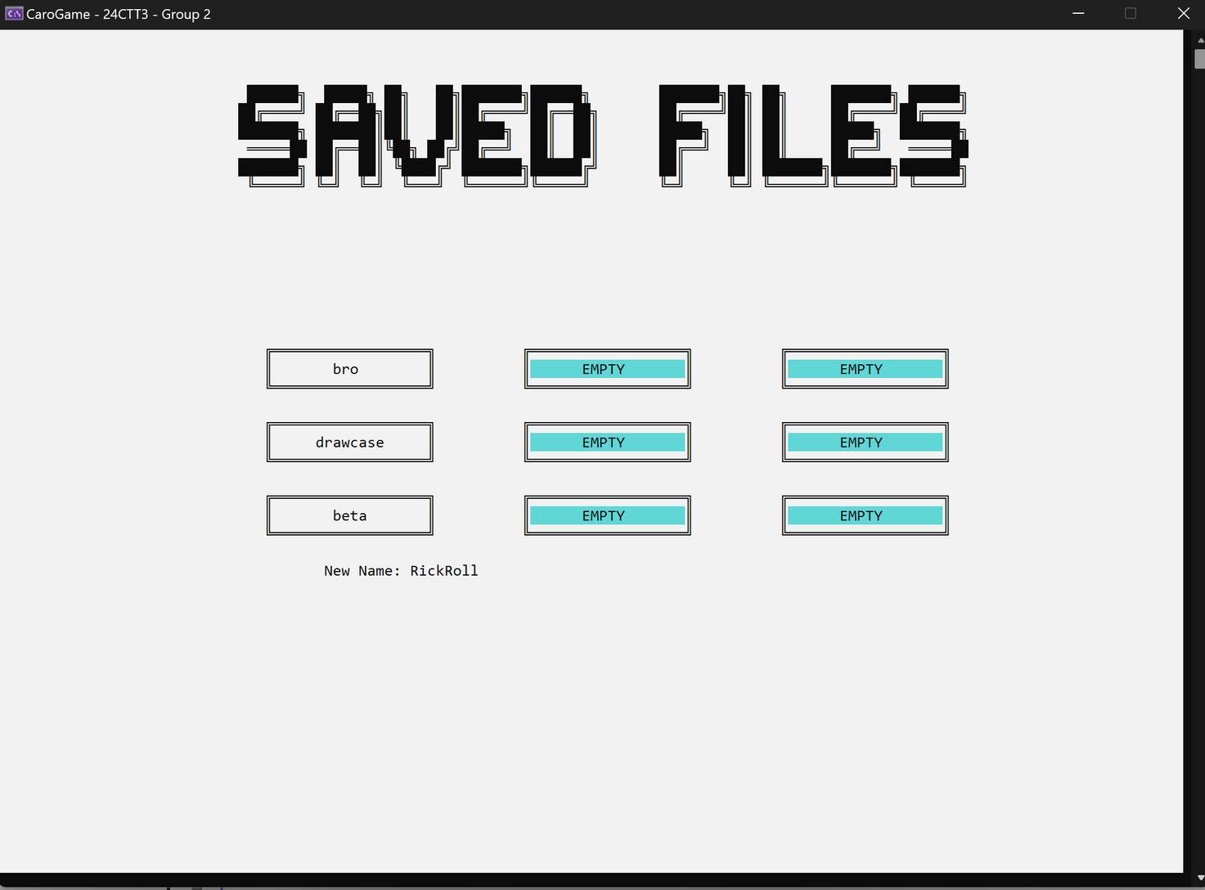
Load game
58

Slide 59

Load game
59

Slide 60
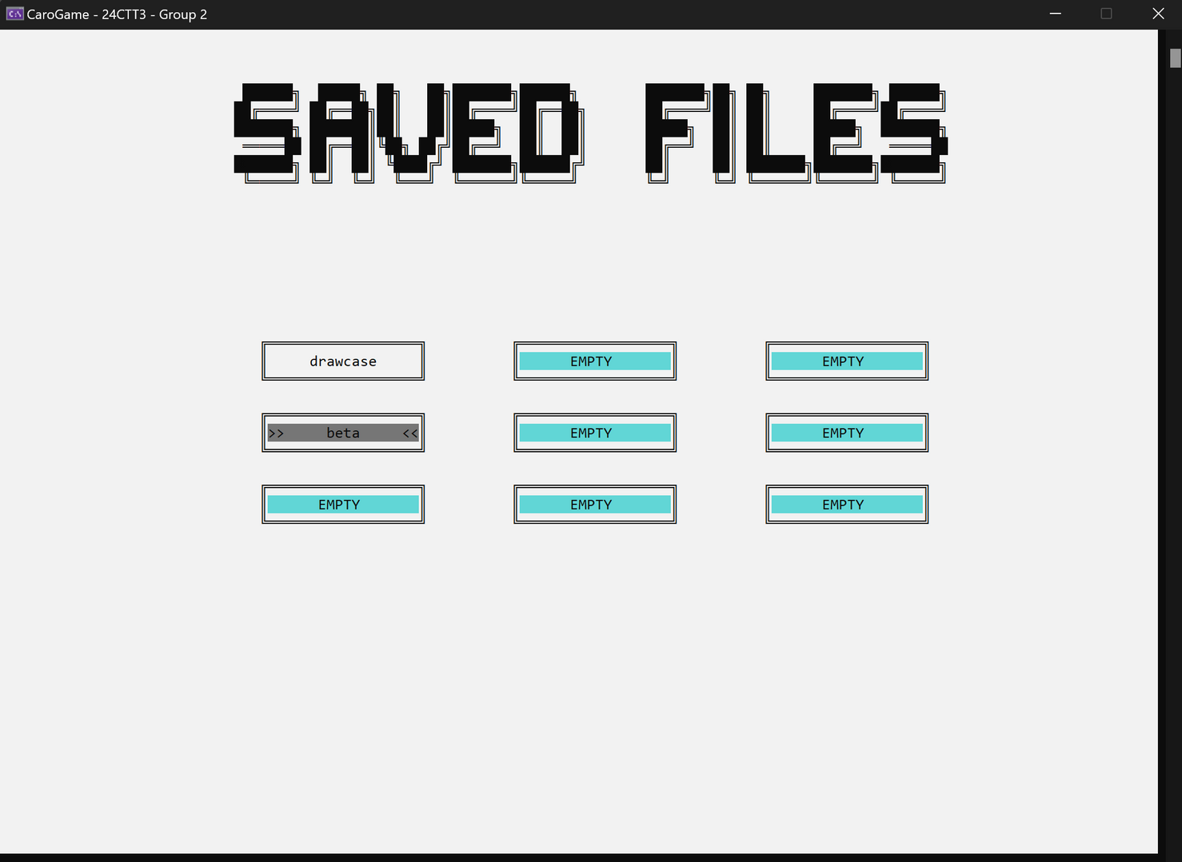
Load game
60

Slide 61
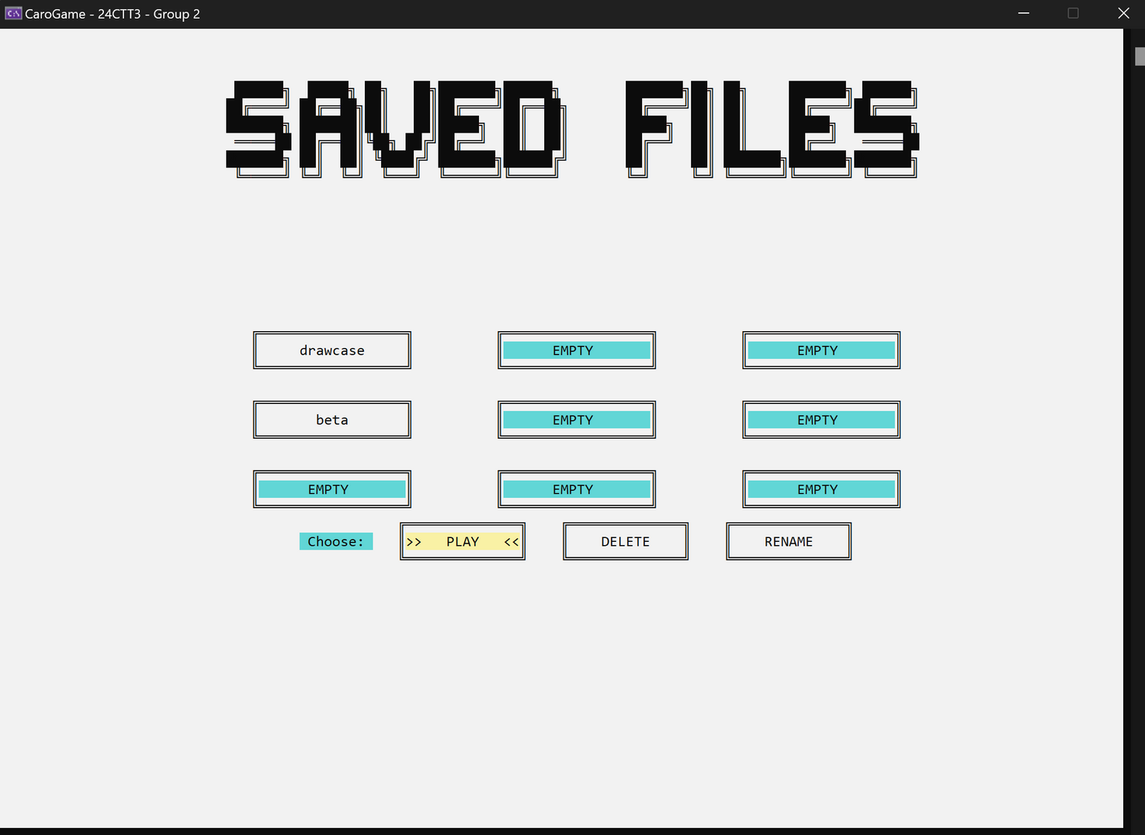
Load game
61

Slide 62
Load game
void loadFromFile(string nameFile, vector<ii>& Data, int& Xscore, int& Oscore, string& name1, string& name2, bool& vsBot) {
Data.clear();
nameFile += ".txt";
ifstream file(nameFile);
int x, y;
file >> vsBot >> Xscore >> Oscore;
file >> name1 >> name2;
while (file >> x >> y) Data.emplace_back(x, y);
file.close();
}
62

Slide 63
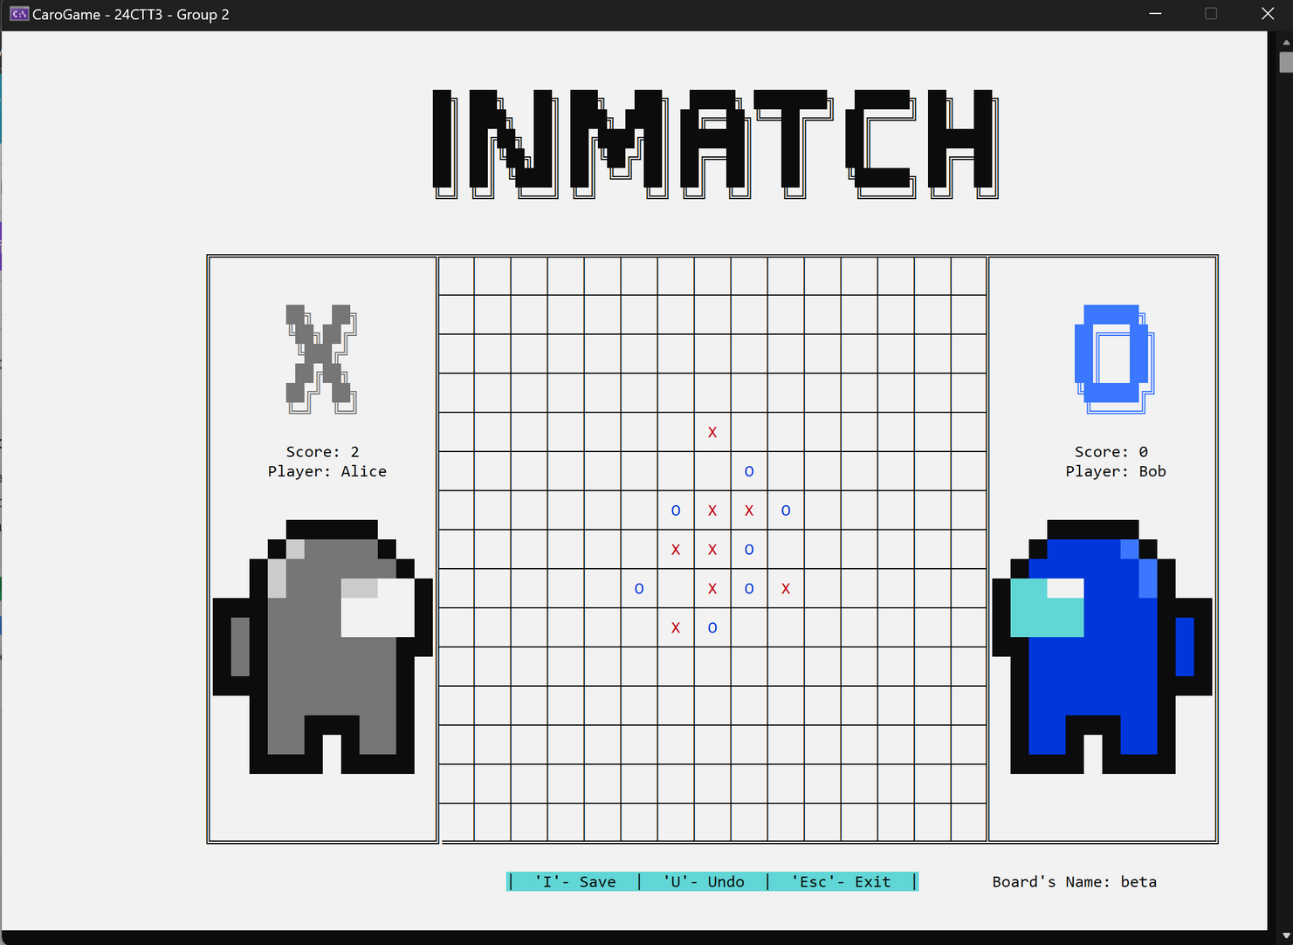
Load game
63

Slide 64
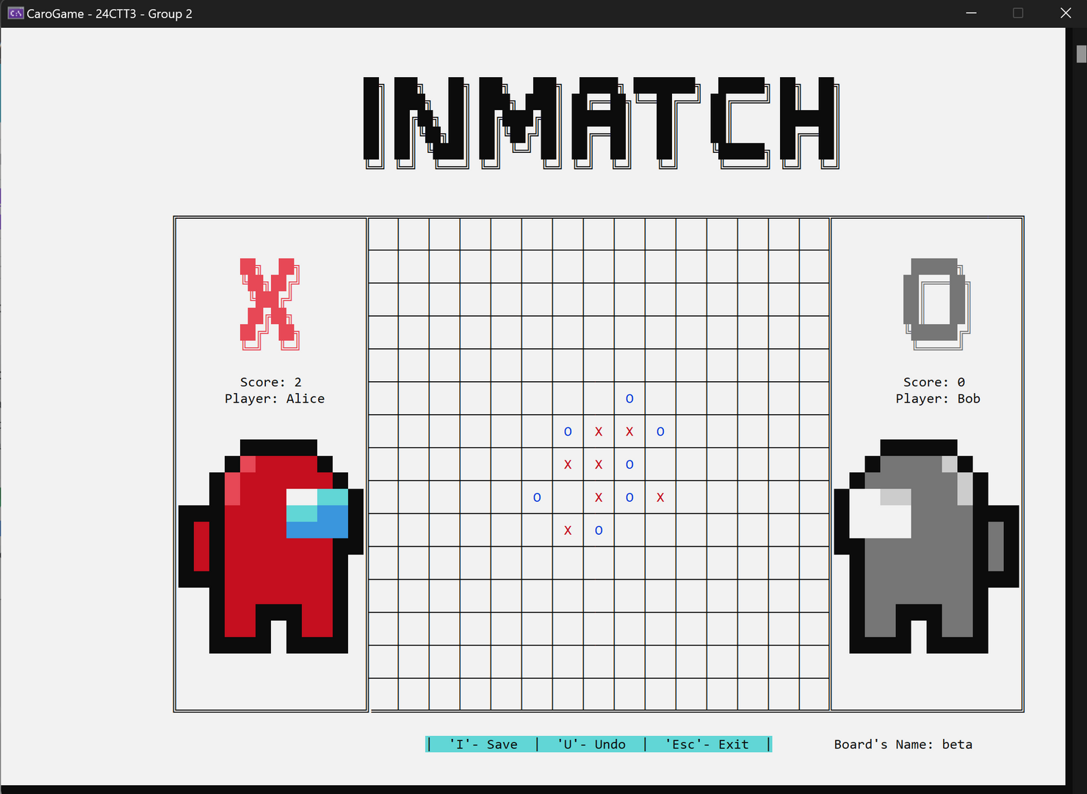
Load game
64

Slide 65
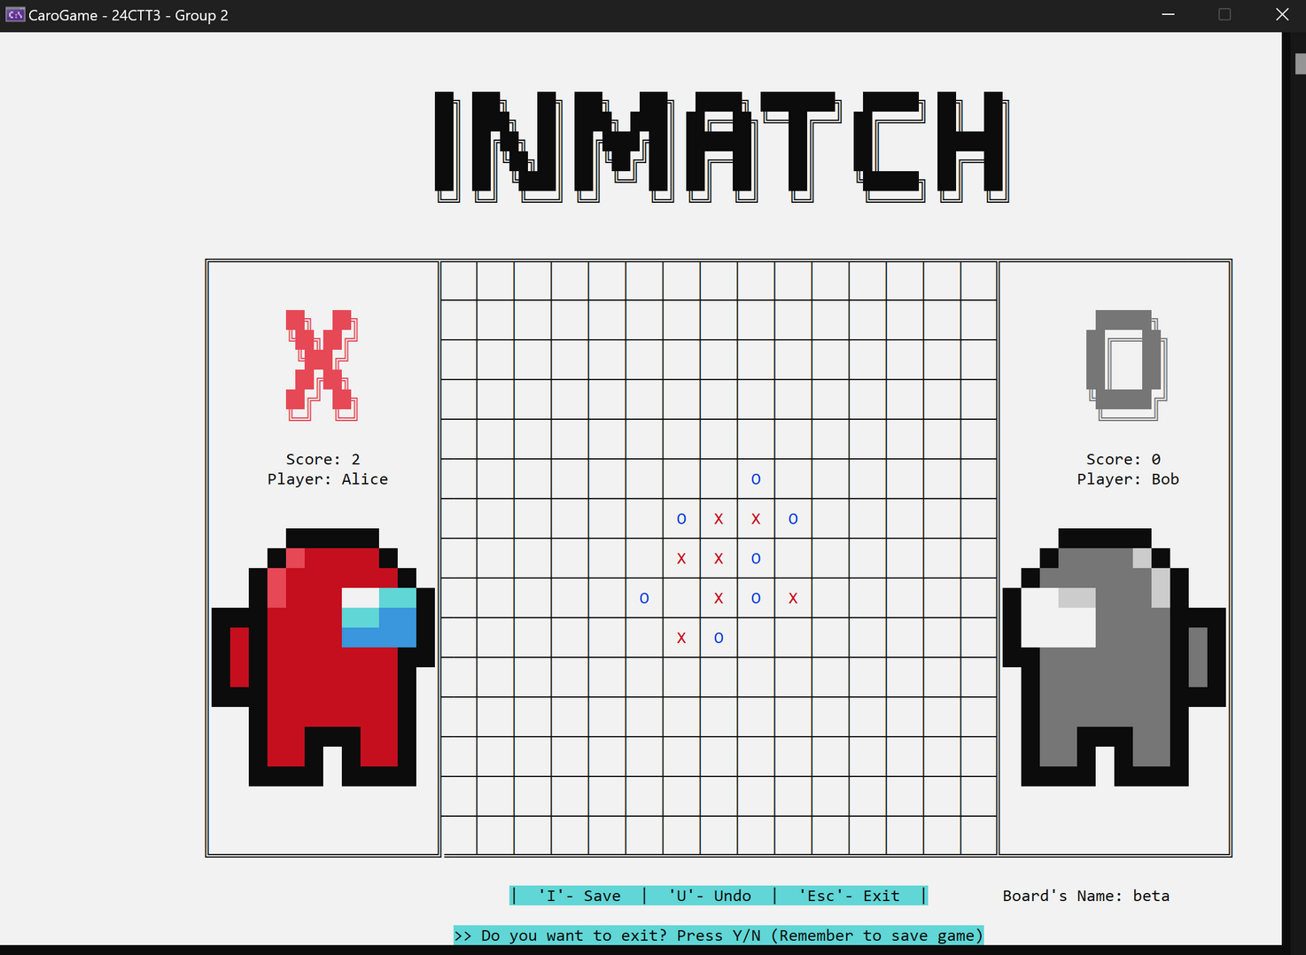
Load game
65

Slide 66
LANGUAGE
66

Slide 67
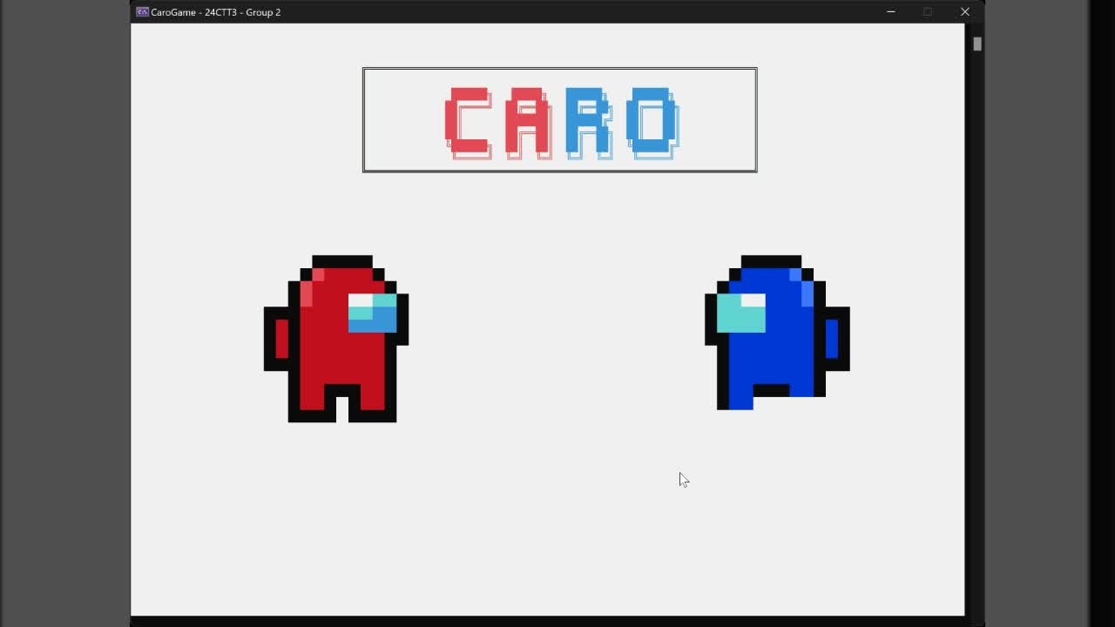
Language
67

Slide 68
Language
map
68

Slide 69
Language
map[key] = value
69

Slide 70
Language
f(x) = y
70

Slide 71
Language
Ví dụ:
english[" NEW GAME "] = " NEW GAME ";
vietnamese[" NEW GAME "] = " TRO CHOI MOI ";
71

Slide 72
Language
New game
selectedLanguage =
vietnamese
english
72

Slide 73
Language
Tro choi moi
New game
selectedLanguage =
vietnamese
english
73

Slide 74
Language
map<string, string> english, vietnamese;
english[" TRO CHOI MOI "] = " NEW GAME ";
english[" TAI TRO CHOI "] = " LOAD GAME ";
vietnamese[" PLAY WITH BOT "] = " CHOI VOI MAY ";
vietnamese[" PLAY WITH HUMAN "] = " CHOI VOI NGUOI ";
cout << (*selectedLanguage)["Language"];
New game
74

Slide 75
THANK YOU
FOR LISTENING
75

